Slide 1
Recommender Systems
An introduction
Dietmar Jannach, TU Dortmund, Germany
Slides presented at PhD School 2014, University Szeged, Hungary
dietmar.jannach@tu-dortmund.de

Slide 2
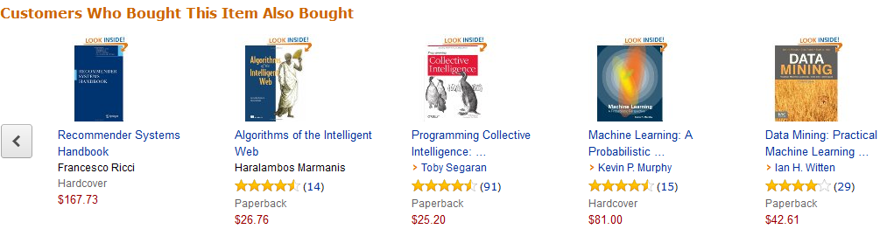
Recommender Systems

Slide 3

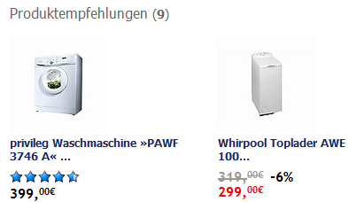
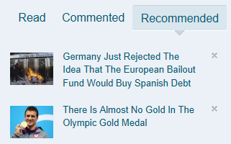
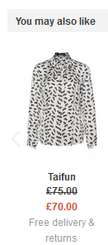
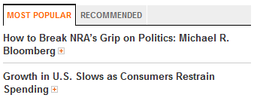
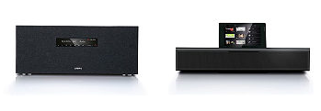
In e-commerce

Slide 4
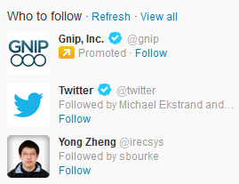
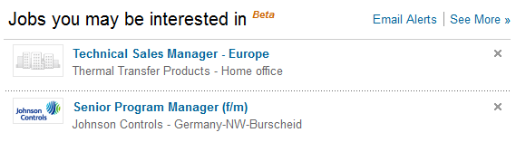
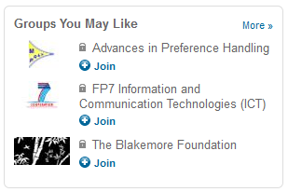
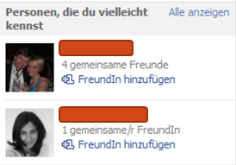
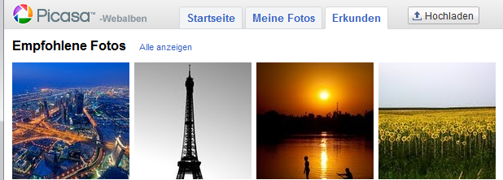
In Social Media

Slide 5
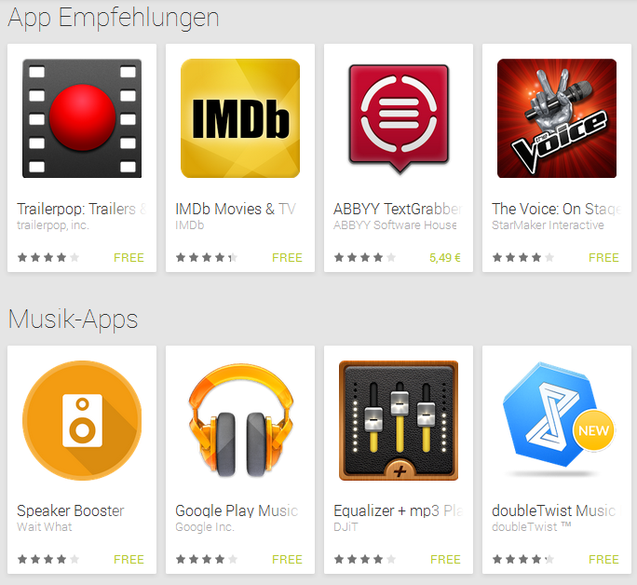
Apps ..

Slide 6
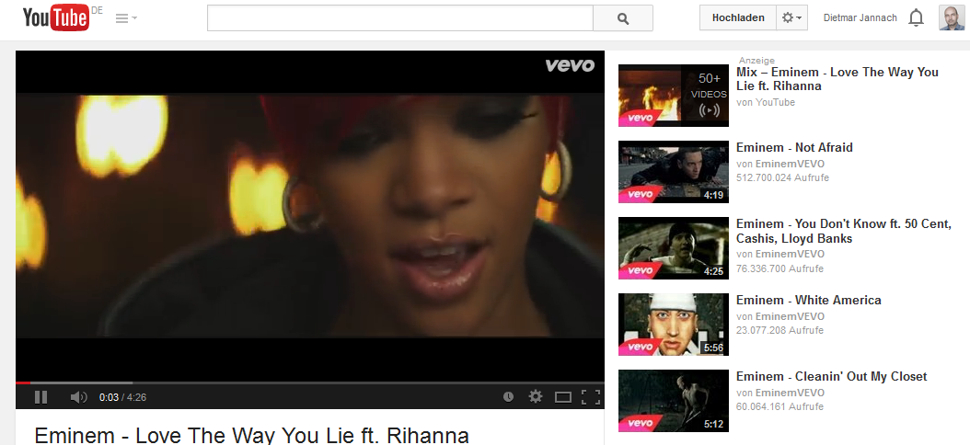
Entertainment

Slide 7

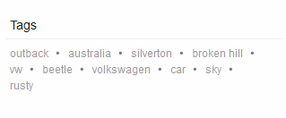
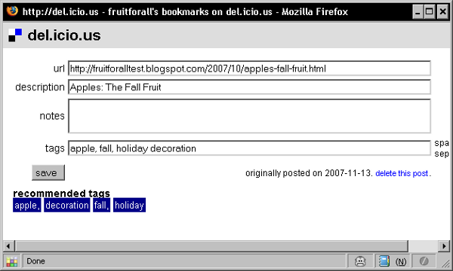
And even more

Slide 8
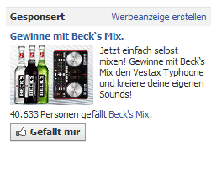

Limitations

Slide 9
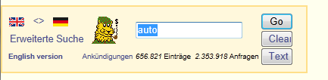
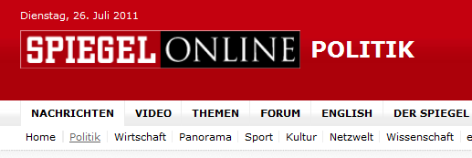
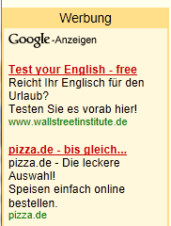
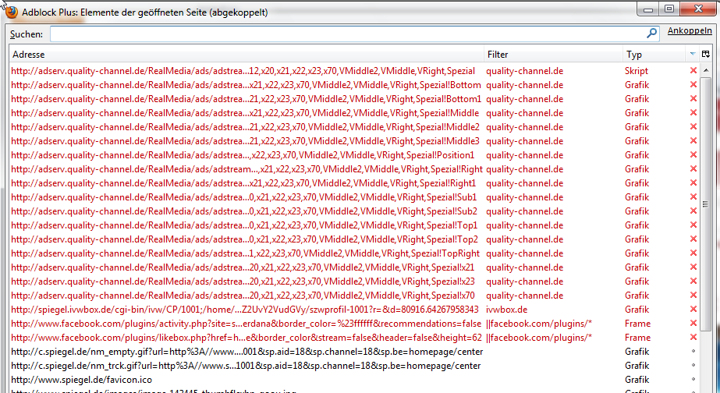
Computational advertising …

Slide 10
About this course
Will give you an introduction to the field of Recommender Systems
  How can you compute recommendations?
  How can we know that the recommendations are good?
  Current limitations and developments in research
  Case studies
Doing a PhD in the field?
  Emerging topics
  Publication outlets
Organization
  Lectures (morning session), exercises (afternoon session)

Slide 11

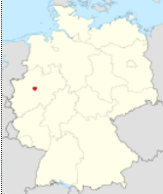

About me
Professor in Computer Science
  At TU Dortmund, Germany
Current research areas
  Recommender Systems
  Errors in spreadsheets
Other topics
  Artificial Intelligence
  Web Mining
  Prouct configuration / Constraints
  …

Slide 12
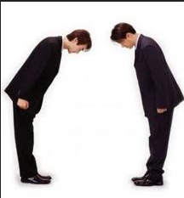
About you

Slide 13


Recommended Reading
Books
  Introduction
  Handbook
Papers …
  ACM Conference on
  Recommender Systems
  WWW, SIGIR, ICDM, KDD,
  UMAP, CHI, …
  Journals on Machine Learning, Data Mining, Information Systems, Data Mining, User Modeling, Human Computer Interaction, …
Special issues on different topics published

Slide 14
Why using Recommender Systems?
Value for the customer
    Find things that are interesting
    Narrow down the set of choices
    Help me explore the space of options
    Discover new things
    Entertainment
    …
Value for the provider
    Additional and probably unique personalized service for the customer
    Increase trust and customer loyalty
    Increase sales, click trough rates, conversion etc.
    Opportunities for promotion, persuasion
    Obtain more knowledge about customers
    …

Slide 15
Real-world check
Myths from industry
    Amazon.com generates X percent of their sales through the recommendation lists (30 < X < 70)
    Netflix (DVD rental and movie streaming) generates X percent of their sales through the recommendation lists (30 < X < 70)
There must be some value in it
    See recommendation of groups, jobs or people on LinkedIn
    Friend recommendation and ad personalization on Facebook
    Song recommendation at last.fm
    News recommendation at Forbes.com (plus 37% CTR)
In academia
  A few studies exist that show the effect
    increased sales, changes in sales behavior

Slide 16
Outline of the lecture
Introduction
How do recommender systems (RS) work ?
  Collaborative filtering
  Content-based filtering
  Knowledge-based recommenders
  Hybrid Systems
How do they influence users and how do we measure their success?
  Different tvaluation designs
  Case study
Selected topics in recommender systems
  Explanations, Trust, Robustness, Multi-criteria ratings, Context-aware recommender systems

Slide 17



Definition – Problem domain
Recommendation systems (RS) help to match users with items
  Ease information overload
    How many books on Amazon?
    How many tracks on iTunes?
  Sales assistance (guidance, advisory, persuasion,…)
  RS are software agents that elicit the interests and preferences of individual consumers […] and make recommendations accordingly.
  They have the potential to support and improve the quality of the
  decisions consumers make while searching for and selecting products online.
                [Xiao & Benbasat, MISQ, 2007]

Slide 18
An often-cited problem characterization
(Adomavicius & Tuzhilin, TKDE, 2005)
Given
  The profile of the "active" user and possibly some situational context
Compute
  A relevance (ranking) score for each recommendable item
The profile …
  … can include past user ratings (explicit or implicit), demographics and interest scores for item features
The problem …
  … is to learn a function that predicts the relevance score for a given (typically unseen) item

Slide 19
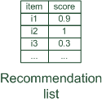

Paradigms of recommender systems
Recommender systems reduce information overload by estimating relevance

Slide 20


Paradigms of recommender systems
Personalized recommendations

Slide 21

Paradigms of recommender systems
Collaborative: "Tell me what's popular among my peers"

Slide 22

Paradigms of recommender systems
Content-based: "Show me more of the same what I've liked"

Slide 23


Paradigms of recommender systems
Knowledge-based: "Tell me what fits based on my needs"

Slide 24
Paradigms of recommender systems
Hybrid: combinations of various inputs and/or composition of different mechanism

Slide 25

Collaborative Filtering

Slide 26

Collaborative Filtering (CF)
The most prominent approach to generate recommendations
    used by large, commercial e-commerce sites
    well-understood, various algorithms and variations exist
    applicable in many domains (book, movies, DVDs, ..)
Approach
    use the preferences of a community to recommend items
Basic assumption and idea
    Users give ratings to catalog items (implicitly or explicitly)
    Patterns in the data help me predict the ratings of individuals, i.e., fill the missing entries in the rating matrix, e.g.,
      there are customers with similar preference structures,
      there are latent characteristics of items that influence the ratings by users
      …

Slide 27
1992: Using collaborative filtering to weave an information tapestry
(D. Goldberg et al., Comm. of the ACM)
Basic idea:
    Eager readers read all docs immediately, casual readers wait for the eager readers to annotate
Experimental mail system at Xerox Parc
    Records reactions of users when reading a mail
Users are provided with personalized mailing list filters instead of being forced to subscribe
    Content-based filters (topics, from/to/subject…)
    Collaborative filters
      "Mails to [all] which were replied by [John Doe] and which received positive ratings from [X] and [Y]."

Slide 28
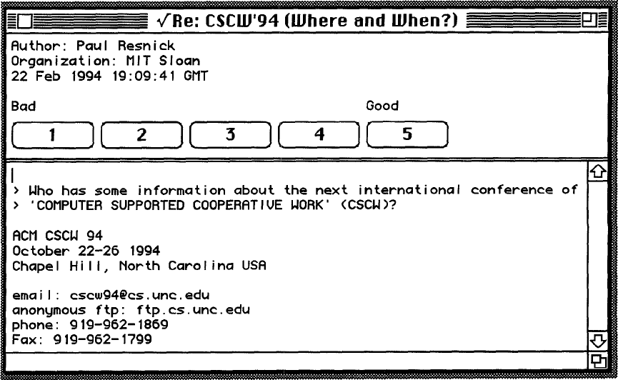
1994: GroupLens: an open architecture for collaborative filtering of netnews
(P. Resnick et al., ACM CSCW )
Tapestry system does not aggregate ratings and requires knowing each other
Basic idea of GroupLens:
  People who agreed in their subjective evaluations in the past are likely to agree again in the future
Builds on newsgroup browsers with rating functionality

Slide 29
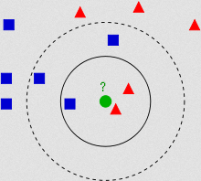
Nearest-neighbors (kNN)
A "pure" CF approach and traditional baseline
    Uses a matrix of (explicit) ratings provided by the community as inputs
    Returns a ranked list of items based on rating predictions
Solution approach
    Given an "active user" (Alice) and an item I not yet seen by Alice
    Estimate Alice's rating for this item based on like-minded users (peers)
Assumptions
    If users had similar tastes in the past they will have similar tastes in the future
    User preferences remain stable and consistent over time

Slide 30
Questions to answer…
How to determine the similarity of two users?
How do we combine the ratings of the neighbors to predict Alice's rating?
Which/how many neighbors' opinions to consider?
 | Item1 | Item2 | Item3 | Item4 | Item5
Alice | 5 | 3 | 4 | 4 | ?
User1 | 3 | 1 | 2 | 3 | 3
User2 | 4 | 3 | 4 | 3 | 5
User3 | 3 | 3 | 1 | 5 | 4
User4 | 1 | 5 | 5 | 2 | 1

Slide 31


1 Determining similarity
A popular measure: Pearson's correlation coefficient
  a, b : users
  r_{a,p} : rating of user a for item p
  P : set of items, rated both by a and b
  : user's average ratings
  Possible similarity values between -1 and 1;
$\overline{r_{a}}$, $\overline{r_{b}}$
 | Item1 | Item2 | Item3 | Item4 | Item5
Alice | 5 | 3 | 4 | 4 | ?
User1 | 3 | 1 | 2 | 3 | 3
User2 | 4 | 3 | 4 | 3 | 5
User3 | 3 | 3 | 1 | 5 | 4
User4 | 1 | 5 | 5 | 2 | 1
sim = 0,85
sim = 0,70
sim = -0,79

Slide 32
Pearson correlation
Takes differences in rating behavior into account
Works well in usual domains, compared with alternative measures
  such as cosine similarity

Slide 33
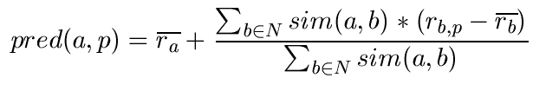
2 Making predictions
A common prediction function:
    Calculate, whether the neighbors' ratings for the unseen item i are higher or lower than their average
    Combine the rating differences – use the similarity with as a weight
    Add/subtract the neighbors' bias from the active user's average and use this as a prediction
How many neighbors?
    Only consider positively correlated neighbors (or higher threshold)
    Can be optimized based on data set
    Often, between 50 and 200

Slide 34
Improved kNN recommendations
(Breese et al., UAI, 1998)
Not all neighbor ratings might be equally "valuable"
    Agreement on commonly liked items is not so informative as agreement on controversial items
    Possible solution: Give more weight to items that have a higher variance
Value of number of co-rated items
    Use "significance weighting", by e.g., linearly reducing the weight when the number of co-rated items is low
Case amplification
    Intuition: Give more weight to "very similar" neighbors, i.e., where the similarity value is close to 1.
Neighborhood selection
    Use similarity threshold or fixed number of neighbors

Slide 35
kNN considerations
Very simple scheme leading to quite accurate recommendations
  Still today often used as a baseline scheme
Possible issues
  Scalability
    Thinking of millions of users and thousands of items
    Pre-computation of similarities possible but potentially unstable
    Clustering techniques are often less accurate
  Coverage
    Problem of finding enough neighbors
    Users with preferences for niche products

Slide 36
2001:Item-based collaborative filtering recommendation algorithms
B. Sarwar et al., WWW 2001
Basic idea:
  Use the similarity between items (and not users) to make predictions
Example:
  Look for items that are similar to Item5
  Take Alice's ratings for these items to predict the rating for Item5
 | Item1 | Item2 | Item3 | Item4 | Item5
Alice | 5 | 3 | 4 | 4 | ?
User1 | 3 | 1 | 2 | 3 | 3
User2 | 4 | 3 | 4 | 3 | 5
User3 | 3 | 3 | 1 | 5 | 4
User4 | 1 | 5 | 5 | 2 | 1

Slide 37
Pre-processing for item-based filtering
Item-based filtering does not solve the scalability problem itself
Pre-processing approach by Amazon.com (in 2003)
  Calculate all pair-wise item similarities in advance
  The neighborhood to be used at run-time is typically rather small, because only items are taken into account which the user has rated
  Item similarities are supposed to be more stable than user similarities
Memory requirements
  Up to N² pair-wise similarities to be memorized (N = number of items) in theory
  In practice, this is significantly lower (items with no co-ratings)
  Further reductions possible
    Minimum threshold for co-ratings
    Limit the neighborhood size (might affect recommendation accuracy)

Slide 38

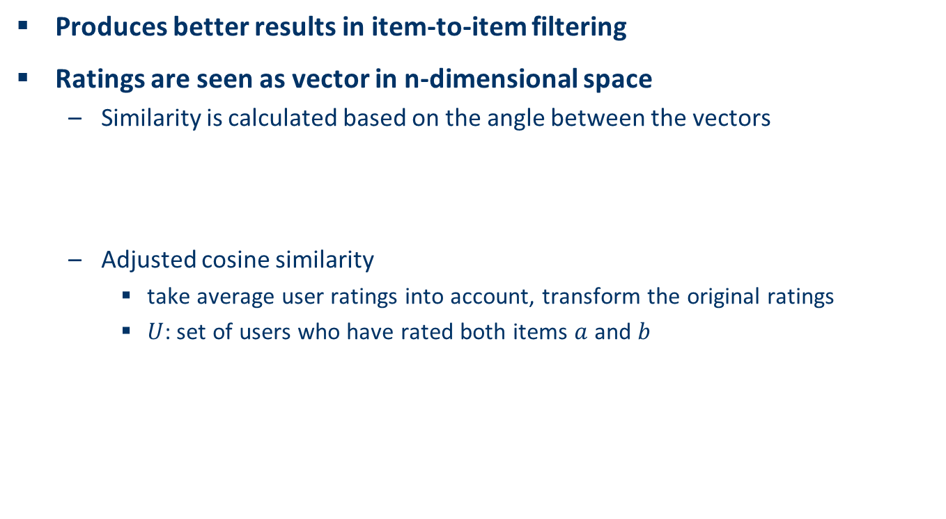
Using (adjusted) cosine similarity
Produces better results in item-to-item filtering
Ratings are seen as vector in n-dimensional space
  Similarity is calculated based on the angle between the vectors
  Adjusted cosine similarity
    take average user ratings into account, transform the original ratings
    $U$: set of users who have rated both items $a$ and $b$
$$sim\left(\vec{a},\vec{b}\right)=\frac{\vec{a}∙\vec{b}}{\left|\vec{a}\right|∗|\vec{b}|}$$

Slide 39
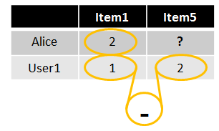
Slope One predictors
(Lemire and Maclachlan, 2005)
Idea of Slope One predictors:
  Based on a popularity differential between items for users
Example:
    p(Alice, Item5) = 2 + (2-1) = 3
Basic scheme:
  Take the average of these differences
  of the co-ratings to make the prediction
  Different variants proposed
In general: find a function of the form f(x) = x + b
  That is why the name is "Slope One"
Can be computationally complex

Slide 40
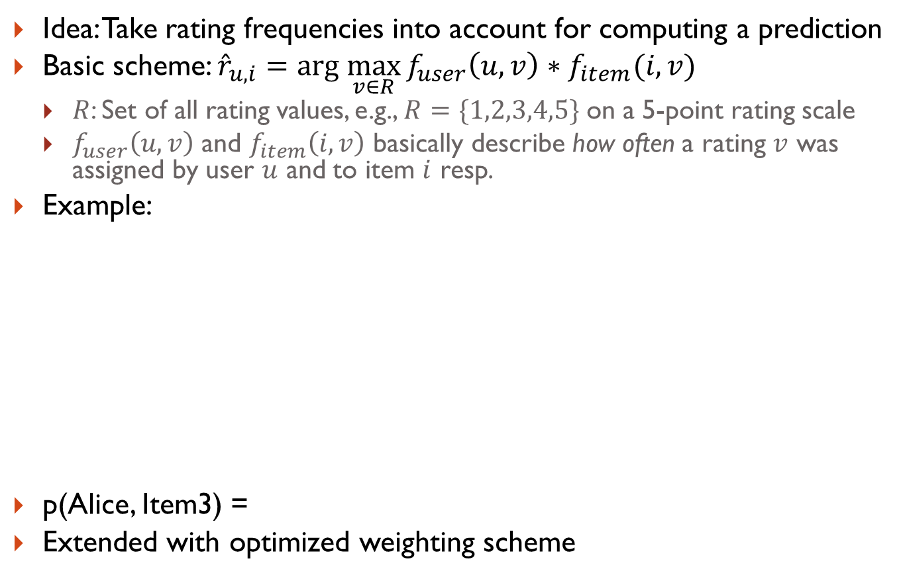
RF-Rec predictors (Gedikli et al. 2011)
Idea: Take rating frequencies into account for computing a prediction
Basic scheme: ${\hat{r}}_{u,i}=arg \max_{v∈R}{f_{user}\left(u,v\right)∗f_{item}(i,v)}$
  $R$: Set of all rating values, e.g., $R=\{1,2,3,4,5\}$ on a 5-point rating scale
  $f_{user}\left(u,v\right)$ and $f_{item}\left(i,v\right)$ basically describe how often a rating $v$ was assigned by user $u$ and to item $i$ resp.
Example:
p(Alice, Item3) =
Extended with optimized weighting scheme
 | Item1 | Item2 | Item3 | Item4 | Item5
Alice | 1 | 1 | ? | 5 | 4
User1 | 2 |  | 5 | 5 | 5
User2 |  |  | 1 | 1
User3 |  | 5 | 2 |  | 2
User4 | 3 |  | 1 | 1
User5 | 1 | 2 | 2 |  | 4
1

Slide 41
Memory- and model-based approaches
kNN methods are often said to be "memory-based"
    the rating matrix is directly used to find neighbors / make predictions
    does not scale for most real-world scenarios
    large e-commerce sites have tens of millions of customers and millions of items
Model-based approaches
    based on an offline pre-processing or "model-learning" phase
    at run-time, only the learned model is used to make predictions
    models are updated / re-trained periodically
    large variety of techniques used
    model-building and updating can be computationally expensive

Slide 42
Model-based approaches
Variety of techniques proposed in recent years, e.g.,
  Matrix factorization techniques
    singular value decomposition, principal component analysis
  Association rule mining
    compare: shopping basket analysis
  Probabilistic models
    clustering models, Bayesian networks, probabilistic Latent Semantic Analysis
  Various other machine learning approaches
    Regression-based techniques, deep neural networks, …
Costs of pre-processing
    Usually not discussed
    Incremental updates possible – algorithms exist

Slide 43
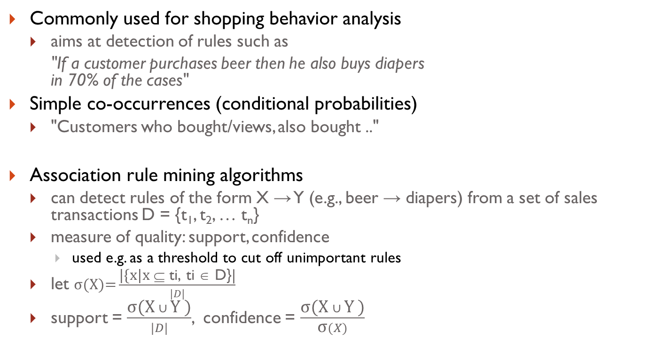
A data mining approach:
Association rule mining
Commonly used for shopping behavior analysis
  aims at detection of rules such as
  "If a customer purchases beer then he also buys diapers
  in 70% of the cases"
Simple co-occurrences (conditional probabilities)
  "Customers who bought/views, also bought .."
Association rule mining algorithms
  can detect rules of the form X → Y (e.g., beer → diapers) from a set of sales transactions D = {t₁, t₂, … t_{n}}
  measure of quality: support, confidence
    used e.g. as a threshold to cut off unimportant rules
  let $\text{σ}\text{(}\text{X}\text{)=}\frac{\text{|\{}\text{x}\text{|}\text{x} \text{⊆ }\text{ti}\text{, }\text{ti}\text{ ∈ }\text{D}\text{\}|}}{|D|}$
  support = $\frac{\text{σ}\text{(}\text{X} ∪ \text{Y}\text{ )}}{|D|}$, confidence = $\frac{\text{σ}\text{(}\text{X} ∪ \text{Y}\text{ )}}{\text{σ}(X)}$

Slide 44
Recommendation based on
Association Rule Mining
 | Item1 | Item2 | Item3 | Item4 | Item5
Alice | 1 | 0 | 0 | 0 | ?
User1 | 1 | 0 | 1 | 0 | 1
User2 | 1 | 0 | 1 | 0 | 1
User3 | 0 | 0 | 0 | 1 | 1
User4 | 0 | 1 | 1 | 0 | 0
Simplest approach
    transform 5-point ratings into
    binary ratings
    (1 = above user average)
Mine rules such as
  Item1 → Item5
    support (2/4), confidence (2/2)
    (without Alice)
Make recommendations for Alice (basic method)
    Determine "relevant" rules based on Alice's transactions
    (the above rule will be relevant as Alice bought Item1)
    Determine items not already bought by Alice
    Sort the items based on the rules' confidence values
Different variations possible
    dislike statements, user associations ..
Can be used for binary/unary ratings and implicit feedback
Different (distributed) algorithms available
    FP-Growth, CFP-Growth, PFP-Growth

Slide 45
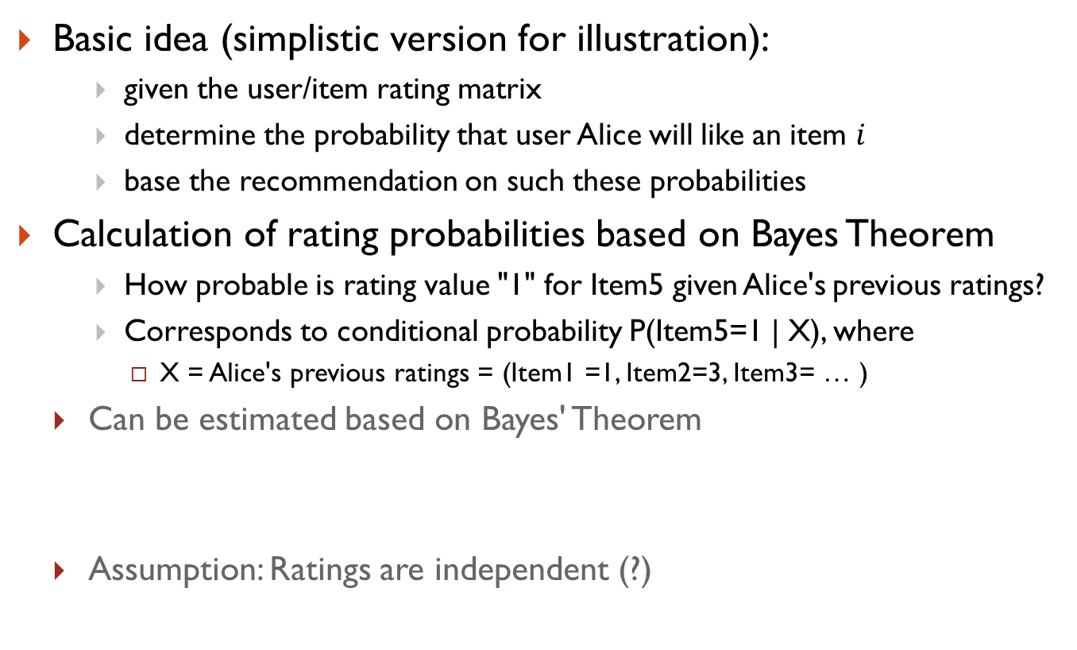
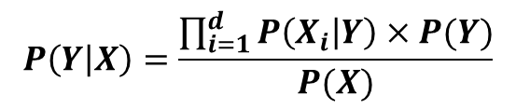
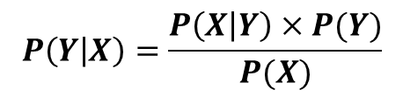
Probabilistic methods
Basic idea (simplistic version for illustration):
    given the user/item rating matrix
    determine the probability that user Alice will like an item $i$
    base the recommendation on such these probabilities
Calculation of rating probabilities based on Bayes Theorem
    How probable is rating value "1" for Item5 given Alice's previous ratings?
    Corresponds to conditional probability P(Item5=1 | X), where
      X = Alice's previous ratings = (Item1 =1, Item2=3, Item3= … )
  Can be estimated based on Bayes' Theorem
  Assumption: Ratings are independent (?)
$$P\left(Y | X\right)=\frac{P\left(X | Y\right)×P(Y)}{P(X)}$$
$$P\left(Y | X\right)=\frac{\prod_{i=1}^{d}{P\left(X_{i} | Y\right)×P(Y)}}{P(X)}$$

Slide 46

Calculation of probabilities (simplistic)
 | Item1 | Item2 | Item3 | Item4 | Item5
Alice | 1 | 3 | 3 | 2 | ?
User1 | 2 | 4 | 2 | 2 | 4
User2 | 1 | 3 | 3 | 5 | 1
User3 | 4 | 5 | 2 | 3 | 3
User4 | 1 | 1 | 5 | 2 | 1
    X = (Item1 =1, Item2=3, Item3= … )
$$P\left(X | Item5=1\right)=P\left(Item1=1 | Item5=1\right)×P\left(Item2=3 | Item5=1\right)×P\left(Item3=3 | Item5=1\right)×P\left(Item4=2 | Item5=1\right)=\frac{2}{2}×\frac{1}{2}×\frac{1}{2}×\frac{1}{2}≈0.125$$
$$P\left(X | Item5=2\right)=P\left(Item1=1 | Item5=2\right)×P\left(Item2=3 | Item5=2\right)×P\left(Item3=3 | Item5=2\right)×P\left(Item4=2 | Item5=2\right)=\frac{0}{0}×⋯×⋯×⋯=0$$
More to consider
  Zeros (smoothing required)
  like/dislike simplification possible

Slide 47
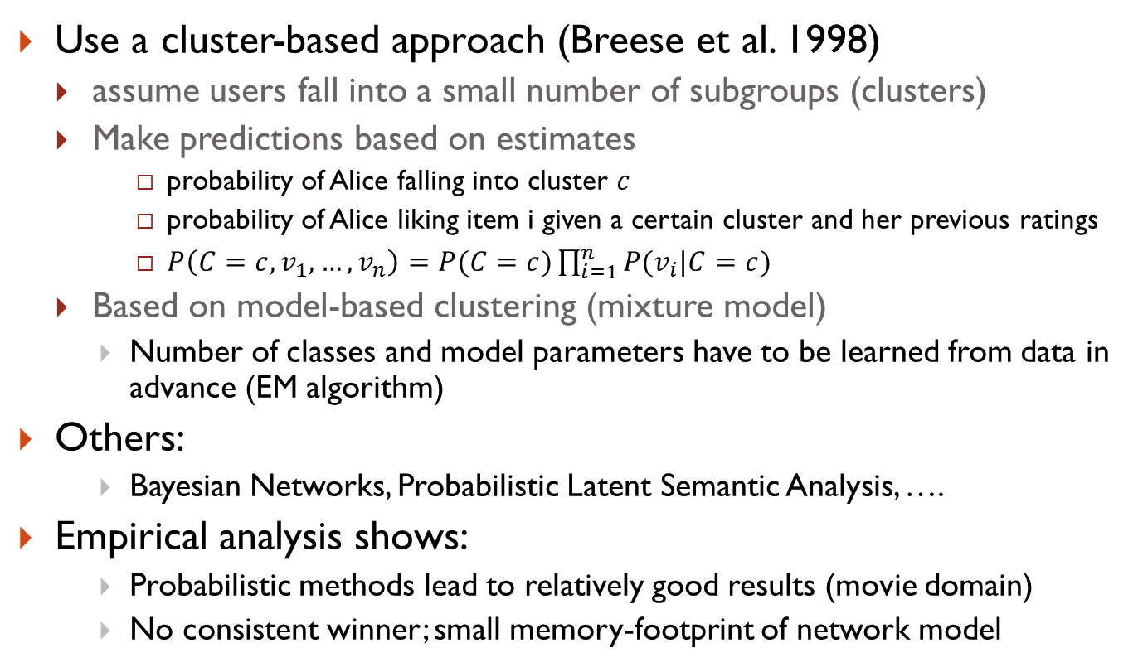
Practical probabilistic approaches
Use a cluster-based approach (Breese et al. 1998)
  assume users fall into a small number of subgroups (clusters)
  Make predictions based on estimates
      probability of Alice falling into cluster $c$
      probability of Alice liking item i given a certain cluster and her previous ratings
      $P\left(C=c,v_{1},…, v_{n}\right)=P(C=c)\prod_{i=1}^{n}{P(v_{i}|C=c)}$
  Based on model-based clustering (mixture model)
    Number of classes and model parameters have to be learned from data in advance (EM algorithm)
Others:
    Bayesian Networks, Probabilistic Latent Semantic Analysis, ….
Empirical analysis shows:
    Probabilistic methods lead to relatively good results (movie domain)
    No consistent winner; small memory-footprint of network model

Slide 48
2000: Application of Dimensionality Reduction in Recommender Systems
(B. Sarwar et al., WebKDD Workshop)
Basic idea:
  Trade more complex offline model building for faster online prediction generation
Singular Value Decomposition for dimensionality reduction of rating matrices
  Captures important factors/aspects and their weights in the data
  Factors can be genre, actors but also non-understandable ones
  Assumption that k dimensions capture the signals and filter out noise (K = 20 to 100)
Constant time to make recommendations
Approach also popular in IR (Latent Semantic Indexing), data compression,…

Slide 49





The "latent factor space"
Sue
Bob
Mary
Alice

Slide 50
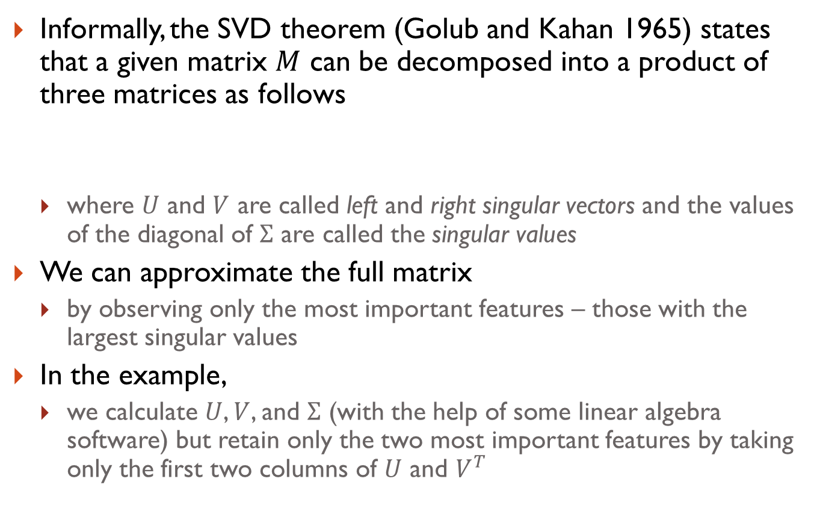
Matrix factorization
Informally, the SVD theorem (Golub and Kahan 1965) states that a given matrix $M$ can be decomposed into a product of three matrices as follows
  where $U$ and $V$ are called left and right singular vectors and the values of the diagonal of $Σ$ are called the singular values
We can approximate the full matrix
  by observing only the most important features – those with the largest singular values
In the example,
  we calculate $U$, $V$, and $Σ$ (with the help of some linear algebra software) but retain only the two most important features by taking only the first two columns of $U$ and $V^{T}$

Slide 51
Example for SVD-based recommendation
U and V correspond to the latent user and item factors
SVD:
Terminator
Die Hard
Twins
Eat Pray Love
Pretty Woman
U_{k} | Dim1 | Dim2
Alice | 0.47 | -0.30
Bob | -0.44 | 0.23
Mary | 0.70 | -0.06
Sue | 0.31 | 0.93
V_{k}^{T}
Dim1 | -0.44 | -0.57 | 0.06 | 0.38 | 0.57
Dim2 | 0.58 | -0.66 | 0.26 | 0.18 | -0.36
 | Dim1 | Dim2
Dim1 | 5.63 | 0
Dim2 | 0 | 3.23
Prediction:
      = 3 + 0.84 = 3.84

Slide 52
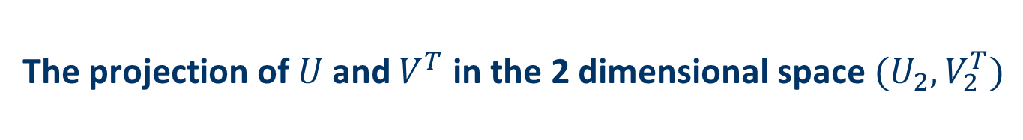
The projection of $U$ and $V^{T}$ in the 2 dimensional space $(U_{2},V_{2}^{T})$
Sue
Terminator
Twins
Bob
Eat Pray Love
Mary
Alice
Pretty Woman
Die Hard

Slide 53
Discussion about dimensionality reduction (Sarwar et al. 2000a)
Matrix factorization
  Projecting items and users in the same n-dimensional space
Prediction quality can decrease because…
  the original ratings are not taken into account
Prediction quality can increase as a consequence of…
  filtering out some "noise" in the data and
  detecting nontrivial correlations in the data
Depends on the right choice of the amount of data reduction
  number of singular values in the SVD approach
  Parameters can be determined and fine-tuned only based on experiments in a certain domain

Slide 54
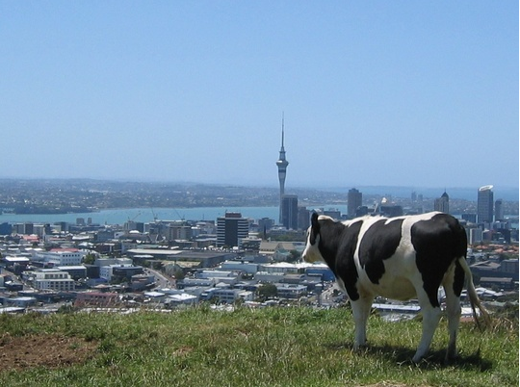
2006 "Funk-SVD" and the Netflix prize
(S. Funk, Try this at home)
Netflix announced a million dollar prize
  Goal:
    Beat their own "Cinematch" system by 10 percent
    Measured in terms of the Root Mean Squared Error
      (evaluation aspects will discussed later on)
  Effect:
    Stimulated lots of research
Idea of SVD and matrix factorization picked up again
  S. Funk (pen name)
    Use fast gradient descent optimization procedure
    http://sifter.org/~simon/journal/20061211.html

Slide 55
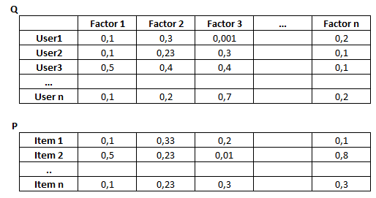
Learn the weights in iterative approach
Start with small initial weights
Repeat
  Make prediction with current model
  Adapt the weights incrementally
    learning rate as a hyperparameter
  Stop after n iterations

Slide 56
2008: Factorization meets the neighborhood: a multifaceted collaborative filtering model
(Y. Koren, ACM SIGKDD)
Combines neighborhood models with latent factor models
  Latent factor models
    good to capture weak signals in the overall data
  Neighborhood models
    good at detecting strong relationships between similar tems
  Combination in one prediction single function
    Includes user- and item bias, considers who rated what
    Add penalty (regularization) for high values to avoid over-fitting

Slide 57
Generalization: An optimization problem
Recommendation is concerned with learning from noisy observations (x,y), where
has to be determined such that
is minimal.
A variety of different learning strategies have been applied trying to estimate f(x)
  Non parametric neighborhood models
  MF models, SVMs and Factorization Machines, Deep Neural Networks, …
  Netflix Prize winner:
    Combine a large number of predictors in ensemble method

Slide 58
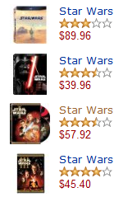
A prediction with 0% error!
Past profile
  You liked Star Wars and
  you gave five stars to Star Wars I to Star Wars III
My prediction is that you
  will give five stars to Star Wars III to
  Star Wars Infinity
  I recommend more Star Wars movies
Exact rating predictions might not enough
  No surprise
    no extra sales and limited value
  No variety in recommendations …

Slide 59
Rating prediction & Item recommendation
Making predictions is typically not the ultimate goal
Usual approach (in academia)
  Rank items based on their predicted ratings
However
  This might lead to the inclusion of (only) niche items
  In practice also: Take item popularity into account
Ranking approaches
  "Learning to rank"
    Recent interest in ranking techniques
    Optimize according to a (proxy of a) given rank evaluation metric

Slide 60
Explicit and implicit ratings
Explicit ratings
    Most commonly used (1 to 5, 1 to 7 Likert response scales)
    Typically only one rating per user and item, including time-stamp
Some research topics
  Data sparsity
    Users not always willing to rate many items
    How to stimulate users to rate more items?
  Which items have (not) been rated?
    Ratings not missing at random
  Optimal granularity of scale
    Indication that 10-point scale is better accepted in movie domain
    An even more fine-grained scale was chosen in the Jester joke recommender
  Multidimensional ratings
    multiple ratings per movie (acting, directing, …)

Slide 61
Explicit and implicit ratings
Implicit ratings (feedback)
  Typically collected by the web shop or application in which the recommender system is embedded
    Clicks, page views, time spent on some page, demo downloads …
    Multiple events over time
  Can be collected constantly and do not require additional efforts from the side of the user
Research topics
  Correct interpretation of the (strength of the) action
    Buy something for a friend, accidental clicks
    How to interpret shopping cart actions (recommend or not?)
  Huge amounts of data to be processed
  Algorithmic questions
    Combination with explicit ratings
      e.g., Koren's SVD++ method
    Specific algorithms (e.g., Bayesian Personalized Ranking)

Slide 62
Data sparsity – cold start situations
How to recommend new items? What to recommend to new users?
A problem even on large platforms
    e.g., hotel review platforms – domain specific issues
Straightforward approaches
    Ask/force users to rate a set of items
    Use another method (e.g., content-based, demographic or simply non-personalized) in the initial phase
    Default voting: assign default values to items that only one of the two users to be compared has rated
Alternatives
    Use better algorithms (beyond nearest-neighbor approaches)
    Exploit additional information sources, e.g., Social Web data
Example:
    In nearest-neighbor approaches, the set of sufficiently similar neighbors might be too small to make good predictions
    Assume "transitivity" of neighborhoods

Slide 63

Example algorithm for sparse datasets
Recursive CF (Zhang and Pu 2007)
    Assume there is a very close neighbor $n$ of $u$ who however has not rated the target item $i$ yet.
    Idea:
      Apply CF-method recursively and predict a rating for item $i$ for the neighbor
      Use this predicted rating instead of the rating of a more distant direct neighbor
 | Item1 | Item2 | Item3 | Item4 | Item5
Alice | 5 | 3 | 4 | 4 | ?
User1 | 3 | 1 | 2 | 3 | ?
User2 | 4 | 3 | 4 | 3 | 5
User3 | 3 | 3 | 1 | 5 | 4
User4 | 1 | 5 | 5 | 2 | 1
sim = 0.85
Predict rating for
User1

Slide 64
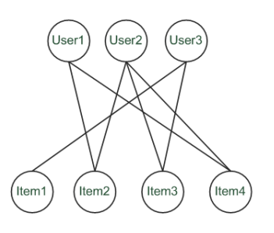
A graph-based approach
Spreading activation (Huang et al. 2004)
  Exploit the supposed "transitivity" of customer tastes and thereby augment the matrix with additional information
  Assume that we are looking for a recommendation for User1
  Standard CF approach:
    User2 will be considered a peer for User1 because they both bought Item2 and Item4
    Item3 will be recommended to User1 because the nearest neighbor, User2, also bought or liked it

Slide 65
A graph-based approach
Spreading activation (Huang et al. 2004)
  Standard CF approaches:
    paths of length 3 will be considered
    Item3 is relevant for User1 because there exists a three-step path (User1–Item2–User2–Item3) between them
  Here:
    The idea is to also consider longer paths (indirect associations) to compute recommendations
    Using path length 5, for instance

Slide 66
Summary CF approaches
Operate on the basis of explicit or implicit feedback of a a user community
  Well-understood, lots of algorithms
  Works in practice
    in particular for quality-and-taste domains
  No information about the items required
Challenges
  Cold start and data sparsity issues
  Scalability can be an issue
  Often no explanations possible
  Not applicable in every domain
    e.g., when specific, short-term user preferences have to be respected or there are complex products (cameras, cars, …)

Slide 67
CF tools and libraries
Some open source solutions exist
  MyMediaLite
    Implements wide range of modern algorithms
    Implemented in C#
  LensKit
    Modular framework built in Java
    Provided by the GroupLens research group
  PREA
    Java-based library of recent CF algorithms
  Apache Mahout, RapidMiner, Apache Spark + MLib
    Implement learning algorithms usable for recommenders
    Mahout: distributed algorithms on Hadoop
  Recommender101
    Java-based framework, several algorithms and metrics

Slide 68
Content-based filtering
"show me more of the same what I've liked"

Slide 69


Content-based Filtering
Again:
  Determine preferences of user based on past behavior
This time, however:
  Look at what the current user liked (purchased, viewed, …)
  Estimate the user's preference for certain item features
    e.g., genre, authors, release date, keywords in the text
  Alternative preference acquisition
    ask the user, look at recently viewed items

Slide 70
What is the "content"?
Most CB-recommendation techniques were applied to recommending text documents.
    Like web pages or newsgroup messages for example.
Content of items can also be represented as text documents.
    With textual descriptions of their basic characteristics.
    Structured: Each item is described by the same set of attributes
    Unstructured: free-text description.
Title | Genre | Author | Type | Price | Keywords
The Night of the Gun | Memoir | David Carr | Paperback | 29.90 | Press and journalism, drug addiction, personal memoirs, New York
The Lace Reader | Fiction, Mystery | Brunonia Barry | Hardcover | 49.90 | American contemporary fiction, detective, historical
Into the Fire | Romance, Suspense | Suzanne Brockmann | Hardcover | 45.90 | American fiction, murder, neo-Nazism

Slide 71
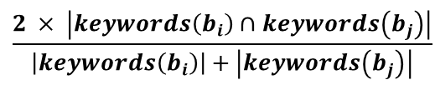
Content representation and item similarities
Represent items and users in the same way
A simple method
    Compute the similarity of an unseen item with the user profile based on the keyword overlap (Dice coefficient)
    Or use and combine multiple metrics
Title | Genre | Author | Type | Price | Keywords
The Night of the Gun | Memoir | David Carr | Paperback | 29.90 | Press and journalism, drug addiction, personal memoirs, New York
The Lace Reader | Fiction, Mystery | Brunonia Barry | Hardcover | 49.90 | American contemporary fiction, detective, historical
Into the Fire | Romance, Suspense | Suzanne Brockmann | Hardcover | 45.90 | American fiction, murder, neo-Nazism
Title | Genre | Author | Type | Price | Keywords
… | Fiction | Brunonia, Barry, Ken Follett | Paperback | 25.65 | Detective, murder, New York
$$\frac{2 × \left|keywords\left(\left.b_{i}\right)\right.∩keywords\left(b_{j}\right)\right|}{\left|keywords\left(\left.b_{i}\right)\right.\right|+\left|keywords\left(\left.b_{j}\right)\right.\right|}$$

Slide 72

Term-Frequency - Inverse Document Frequency ($TF−IDF$)
Simple keyword representation has its problems
  in particular when automatically extracted:
    not every word has similar importance
    longer documents have a higher chance to have an overlap with the user profile
Standard measure: TF-IDF
  Encodes text documents in multi-dimensional Euclidian space
    weighted term vector
  TF: Measures, how often a term appears (density in a document)
    assuming that important terms appear more often
    normalization has to be done in order to take document length into account
  IDF: Aims to reduce the weight of terms that appear in all documents

Slide 73
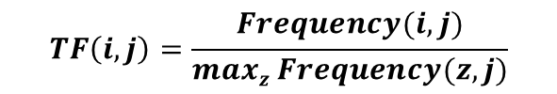
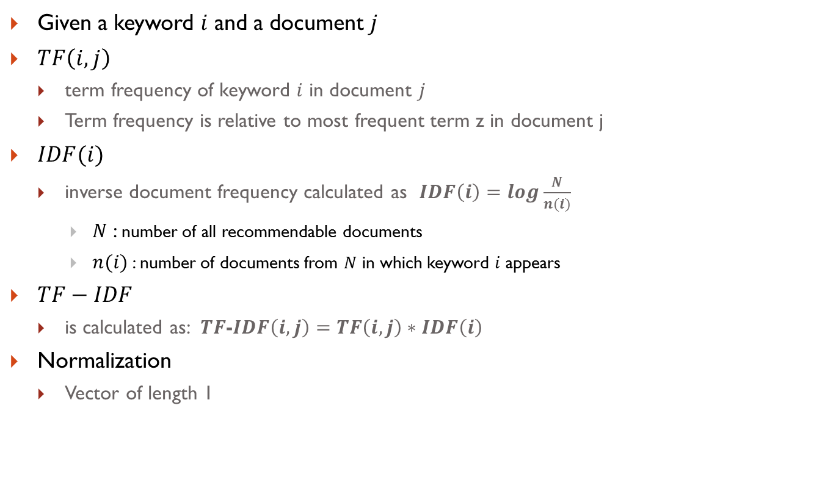

TF-IDF calculation
Given a keyword $i$ and a document $j$
$TF\left(i,j\right)$
  term frequency of keyword $i$ in document $j$
  Term frequency is relative to most frequent term z in document j
$IDF(i)$
  inverse document frequency calculated as $IDF\left(i\right)=log\frac{N}{n(i)}$
    $N$ : number of all recommendable documents
    $n(i)$: number of documents from $N$ in which keyword $i$ appears
$TF−IDF$
  is calculated as: $TF$-$IDF\left(i,j\right)=TF\left(i,j\right)∗IDF\left(i\right)$
Normalization
  Vector of length 1
$$TF\left(i,j\right)=\frac{\begin{aligned}Frequency(i,j)\end{aligned}}{maxz Frequency(z,j)}$$
$$TF−IDF\left(i,j\right)=\frac{\begin{aligned}TF−IDF(i,j)\end{aligned}}{\sqrt{\sum_{s}{{TF−IDF(s,j)}^{2}}}}$$

Slide 74
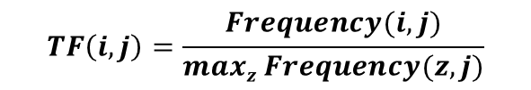
Example TF-IDF representation
Absolute term frequency:
  Each document is a count vector in $ℕ^{\left|v\right|}$
 | Poem A | Poem B | Poem C
Caesar | 232 | 0 | 2
Calpurnia | 0 | 10 | 0
Cleopatra | 57 | 0 | 0
  Vector $v$with dimension $\left|v\right|=3$
TF | Poem A | Poem B | Poem C
Caesar | 1 | 0 | 1
Calpurnia | 0 | 1 | 0
Cleopatra | 0.24 | 0 | 0
$$TF\left(i,j\right)=\frac{\begin{aligned}Frequency(i,j)\end{aligned}}{maxz Frequency(z,j)}$$
Notes:
10/232 = 0.043

Slide 75
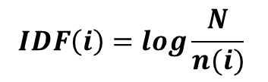
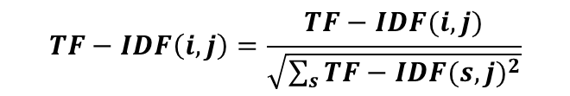

Example TF-IDF representation
$$IDF\left(i\right)=log\frac{N}{n(i)}$$
 | Poem A | Poem B | Poem C
Caesar | 232 | 0 | 2
Calpurnia | 0 | 10 | 0
Cleopatra | 57 | 0 | 0
IDF | Poem A | Poem B | Poem C
Caesar | 0.58 | 0 | 0.58
Calpurnia | 0 | 1.58 | 0
Cleopatra | 1.58 | 0 | 0
$TF$-$IDF\left(i,j\right)=TF\left(i,j\right)∗IDF\left(i\right)$
$$TF−IDF\left(i,j\right)=\frac{\begin{aligned}TF−IDF(i,j)\end{aligned}}{\sqrt{\sum_{s}{{TF−IDF(s,j)}^{2}}}}$$
TF-IDF | Poem A | Poem B | Poem C
Caesar | 0.58 | 0 | 1
Calpurnia | 0 | 1.58 | 0
Cleopatra | 0.39 | 0 | 0
Norm. TF-IDF | Poem A | Poem B | Poem C
Caesar | 0.83 | 0 | 1
Calpurnia | 0 | 1 | 0
Cleopatra | 0.55 | 0 | 0
Given numbers are not correct here…

Slide 76
Improving the vector space model
Vectors are usually long and sparse
Remove stop words
  They will appear in nearly all documents.
  e.g. "a", "the", "on", …
Use stemming
  Aims to replace variants of words by their common stem
  e.g. "went" "go", "stemming" "stem", …
Size cut-offs
  only use top n most representative words to remove "noise" from data
  e.g. use top 100 words
Tuning of representation
  Logarithmic instead of linear TF count

Slide 77
Improving the vector space model
Use lexical knowledge, use more elaborate methods for feature selection
  Remove words that are not relevant in the domain
Detection of phrases/n-grams
  More descriptive for a text than single words
  e.g. "United Nations"
Limitations
  semantic meaning remains unknown
  example: usage of a word in a negative context
    "there is nothing on the menu that a vegetarian would like.."
    The word "vegetarian" will receive a higher weight then desired
    an unintended match with a user interested in vegetarian restaurants

Slide 78
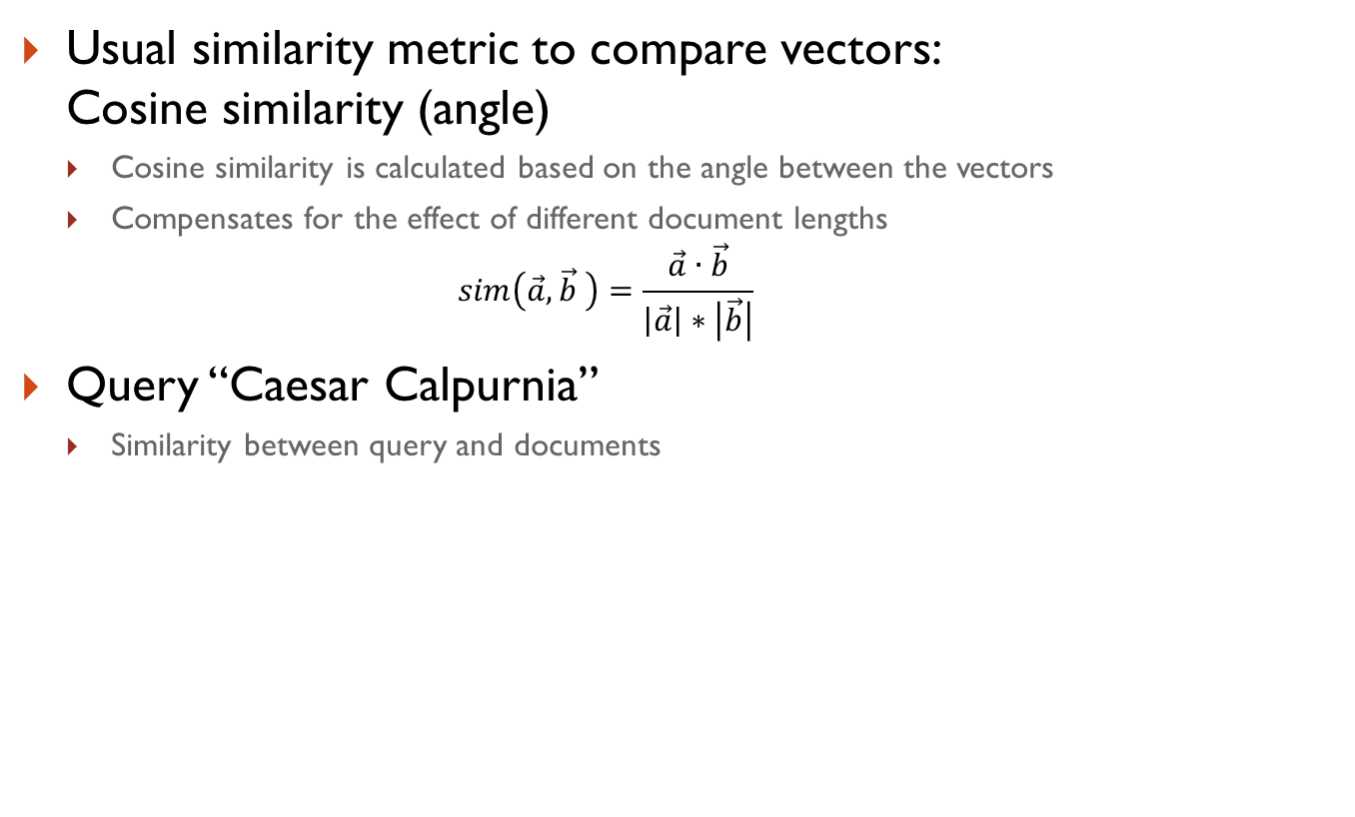
Comparing the vectors (users/items)
Usual similarity metric to compare vectors:
Cosine similarity (angle)
  Cosine similarity is calculated based on the angle between the vectors
  Compensates for the effect of different document lengths
    $$sim\left(\vec{a},\vec{b} \right)=\frac{\vec{a}∙\vec{b}}{\left|\vec{a}\right|∗\left|\vec{b}\right|}$$
Query “Caesar Calpurnia”
  Similarity between query and documents
Norm. TF-IDF | Antony and Cleopatra | Julius Caesar | Hamlet | Query
Caesar | 0.83 | 0 | 1 | 0.35
Calpurnia | 0 | 1 | 0 | 0.94
Cleopatra | 0.55 | 0 | 0 | 0
Similarity to query | 0.29 | 0.94 | 0.35 | 1

Slide 79

Recommending items
Item recommendation: nearest neighbors
  Given a set of documents$D$already rated by the user (like/dislike)
    Either explicitly via user interface
    Or implicitly by monitoring user's behavior
  Find the $n$ nearest neighbors of a not-yet-seen item $i$ in $D$
    Use similarity measures (like cosine similarity) to capture similarity between two documents
Rating predictions
  Take these neighbors to predict a rating for $i$
    e.g. $k=5$ most similar items to$i$.
    4 of $k$ items were liked by current user item $i$ will also be liked by this user
  Variations:
    Varying neighborhood size k
    lower/upper similarity thresholds to prevent system from recommending items the user already has seen
  Good to model short-term interests / follow-up stories
  Used in combination with method to model long-term preferences

Slide 80
Rocchio's method
Retrieval quality depends on individual capability to formulate queries with suitable keywords
Query-based retrieval: Rocchio's method
  The SMART System: Users are allowed to rate (relevant/irrelevant) retrieved documents (feedback)
  The system then learns a prototype of relevant/irrelevant documents
  Queries are then automatically extended with additional terms/weight of relevant documents

Slide 81



Rocchio details
Document collections D⁺ (liked) and D⁻ (disliked)
  Calculate prototype vector for these categories.
  Computing modified query Qi+1 from
  current query Qi with:
  α, β, γ used to fine-tune the feedback
    α weight for original query
    β weight for positive feedback
    γ weight for negative feedback
$$Q_{i+1}= α ∗ Q_{i}+ β\left(\frac{1}{\left|D^{+}\right|} \sum_{d^{+}∈D^{+}}{d^{+}}\right)− γ\left(\frac{1}{\left|D^{−}\right|}\sum_{d^{−}∈D^{−}}{d^{−}}\right)$$
  Often only positive feedback is used
  More valuable than negative feedback

Slide 82

Probabilistic methods
Recommendation as classical text classification problem
  long history of using probabilistic methods
Simple approach:
    2 classes: hot/cold
    Simple Boolean document representation
    Calculate probability that document is hot/cold based on Bayes theorem
Doc-ID | recommender | intelligent | learning | school | Label
1 | 1 | 1 | 1 | 0 | 1
2 | 0 | 0 | 1 | 1 | 0
3 | 1 | 1 | 0 | 0 | 1
4 | 1 | 0 | 1 | 1 | 1
5 | 0 | 0 | 0 | 1 | 0
6 | 1 | 1 | 0 | 0 | ?
$$P\left(X | Label=1\right)=P\left(recommender=1 | Label=1\right)×P\left(intelligent =1 | Label=1\right)×P\left(learning =0 | Label=1\right)×P\left(school =0 | Label=1\right)=3/3×2/3×1/3×2/3≈0.149$$

Slide 83
Improvements
Side note: Conditional independence of events does in fact not hold
  "New York", "Hong Kong"
  Still, good accuracy can be achieved
Boolean representation simplistic
  positional independence assumed
  keyword counts lost
More elaborate probabilistic methods
  e.g., estimate probability of term v occurring in a document of class C by relative frequency of v in all documents of the class
Probabilistic Latent Semantic Analysis
  Find latent topics within documents (compare Matrix Factorization and SVD methods)
Other linear classification algorithms (machine learning) can be used
  Support Vector Machines, ..

Slide 84


Linear classifiers
Most learning methods aim to find coefficients of a linear model
  A simplified classifier with only two
  dimensions can be represented by a line
  The line has the form $w_{1}x_{1}+w_{2}x_{2}=b$
  $x_{1}$ and $x_{2}$correspond to the vector
  representation of a document
  (using e.g. TF-IDF weights)
  $w_{1},w_{2}$ and $b$ are parameters to be learned
  Classification of a document based on checking
  $w_{1}x_{1}+w_{2}x_{2}>b$
  In n-dimensional space the classification function is ${\vec{w}}^{T}\vec{x}=b$

Slide 85

On feature selection
Process of choosing a subset of available terms
Different strategies exist for deciding which features to use
  Feature selection based on domain knowledge and lexical information from WordNet
  Frequency-based feature selection to remove words appearing "too rare" or "too often"
Not appropriate for larger text corpora
  Better to
    evaluate value of individual features (keywords) independently and
    construct a ranked list of "good" keywords.
  Typical measure for determining utility of keywords:
  e.g. $X^{2}$, mutual information measure or Fisher's discrimination index

Slide 86
Limitations of content-based methods
Keywords alone may not be sufficient to judge quality/relevance of a document or web page
  up-to-date-ness, usability, aesthetics, writing style
  content may also be limited / too short
  content may not be automatically extractable (multimedia)
Ramp-up phase required
  Some training data is still required
  Web 2.0: Use other sources to learn the user preferences
Overspecialization
  Algorithms tend to propose "more of the same"
  Or: too similar news items

Slide 87
Discussion & summary
Content-based techniques do not require a user community
    They however require content information
    Recent new types of "content" information
      Wikipedia, Linked Data, Social Tags, Social Media posts…
The presented approaches learn a model of the user's interest preferences based on explicit or implicit feedback
    Deriving implicit feedback from user behavior can be problematic
Danger exists that recommendation lists contain too many similar items
    All learning techniques require a certain amount of training data
    Some learning methods tend to overfit the training data
Research focuses on CF methods, in practice, however
    Content-based methods work well in some domains

Slide 88
A case study – mobile games
Typical in research
  Offline evaluation (historical datasets)
  Optimize accuracy or rank metric
What about the business value?
  Nearly no real-world studies
  Exceptions, e.g., Dias et al., 2008.
    e-Grocer application
    CF method
      short term: below one percent
      long-term, indirect effects important
This study
  measuring impact of different RS algorithms in Mobile Internet scenario
  more than 3% more sales through personalized item ordering

Slide 89

The application context
Game download platform of telco provider
  access via mobile phone
  direct download, charged to monthly statement
  low cost items (0.99 cent to few Euro)
Extension to existing platform
  "My recommendations"
  in-category personalization (where applicable)
  start-page items, post-sales items
Control group
  natural or editorial item ranking
  no "My Recommendations"

Slide 90
Study setup (A/B test)
6 recommendation algorithms, 1 control group
    CF (item-item, SlopeOne), Content-based filtering, Switching CF/Content-based hybrid, top rating, top selling
Test period:
    4 weeks evaluation period
    about 150,000 users assigned randomly to different groups
    only experienced users
Hypotheses on personalized vs. non-personalized recommendation techniques and their potential to
    Increase conversion rate (i.e. the share of users who become buyers)
    Stimulate additional purchases (i.e. increase the average shopping basket size)

Slide 91
Measurements
Click and purchase behavior of customers
  Customers are always logged in
  All navigation activities stored in system
Measurements taken in different situations
  "My Recommendations", start page, post sales, in categories, overall effects
  Metrics
    item viewers/platform visitors
    item purchasers/platform visitors
    item views per visitor
    purchases per visitor
Implicit and explicit feedback
  item view, item purchase, explicit ratings

Slide 92


"My Recommendations" conversion rates
Conversion rates
    Top-rated items (SlopeOne, Top-Rating) appear to be non-interesting
    Only CF-Item able to turn more visitors into buyers (p < 0.01)
Overall on the platform
    No significant increase on both conversion rates (for frequent users!)
viewers/visitors
buyers/visitors

Slide 93


"My Recommendations" sales increase (1)
Item views:
    Except SlopeOne, all personalized RS outperform non-personalized techniques
Item purchases
    RS measurably stimulate users to buy/download more items
    Content-based method does not work well here
views/visit
purchases/visit

Slide 94

"My Recommendations" sales increase (2)
Demos and non-free games:
  Previous figures counted all downloads
  Figure shows
    Personalized techniques comparable to top seller list
    However, can stimulate interest in demo games
Figure shows purchases
per visitor rate

Slide 95


Post-sales recommendations
Findings
  recommending "more-of-the-same", top sellers or simply new items does not work well
  Top-Rating and SlopeOne nearly exclusively stimulate demo downloads (Not shown)
  Top-Seller und control group sell no demos

Slide 96


Overall effects
Notes:
  In-category measurements not shown in paper
  Content-based method outperforms others in different categories
    half price, new games, erotic games
  Effect: 3.2 to 3.6% sales increase!
Overall number of downloads
  free + non-free games
Pay games only

Slide 97
Observations & Summary
Only 2% of users issued at least one rating
    Most probably caused by size of displays
      In addition: particularity of platform; rating only after download
    Explicit feedback not sufficient, implicit feedback required
Recommendation in navigational context
    Acceptance of recommendation depends on situation of user
Summary
  Significant sales increase can be reached!
    max. 1% in past with other activities
  More studies needed
  Limitations of accuracy measures

Slide 98
Recommender Systems
An introduction
Dietmar Jannach, TU Dortmund, Germany
Slides presented at PhD School 2014, University Szeged, Hungary
dietmar.jannach@tu-dortmund.de

Slide 99

Evaluating recommender systems

Slide 100


What is a good recommendation?
This might lead to …
  What is a good recommendation?
  What is a good recommendation strategy?
  What is a good recommendation strategy for my business?
We hope you will buy also …
These have been in stock for quite a while now …

Slide 101



What is a good recommendation?
  What are the measures in practice?
Total sales numbers
Promotion of certain items
…
Click-through-rates
Interactivity on platform
…
Customer return rates
Customer satisfaction and loyalty

Slide 102





How do we as researchers know?
Test with real users
  A/B tests
  Example measures: sales increase, click through rates
Laboratory studies
  Controlled experiments
  Example measures: satisfaction with the system (questionnaires)
Offline experiments
  Based on historical data
  Example measures: prediction accuracy, coverage

Slide 103

In academia – evaluation approaches

Slide 104
Empirical research
Characterizing dimensions:
  Who is the subject that is in the focus of research?
  What research methods are applied?
  In which setting does the research take place?
Subject | Online customers, students, historical online sessions, computers, …
Research method | Experiments, quasi-experiments, non-experimental research
Setting | Lab, real-world scenarios

Slide 105
Evaluation settings (w. users)
Lab studies
  Explicitly created for the purpose of the study
  Extraneous variables can be controlled more easy by selecting study participants
  But doubts may exist about participants motivated by money or prizes
Participants should behave as they would in a real-world environment
  But they actually do not buy things
Field studies
  Conducted in an preexisting real-world environment
  Users are intrinsically motivated to use a system

Slide 106
Research methods
Experimental vs. non-experimental (observational) research methods
  Experiment (test, trial):
    "An experiment is a study in which at least one variable is manipulated and units are randomly assigned to different levels or categories of manipulated variable(s)."
    Units : users, historic sessions, …
    Manipulated variable : type of RS, groups of recommended items,
    explanation strategies …
    Categories of manipulated variable(s): content-based RS, collaborative RS
  Different experimental designs
    Between subjects
    Within subjects
    Mixed designs

Slide 107

Experiment designs

Slide 108
Different approaches in different fields
„How to“ from different perspectives:
  Information Retrieval
  Machine Learning
  HCI and Decision Support

Slide 109
Evaluation in information retrieval (IR)
Historical Cranfield collection (late 1950s)
    1,398 journal article abstracts
    225 queries
    Exhaustive relevance judgements (over 300K)
Ground truth established by human domain experts
 |  | Reality
 |  | Actually Good | Actually Bad
Prediction | Rated Good | True Positive (tp) | False Positive (fp)
 | Rated Bad | False Negative (fn) | True Negative (tn)
All recommended items
All good items

Slide 110


Metrics: Precision and Recall
Recommendation is viewed as information retrieval task:
  Retrieve (recommend) all items which are predicted to be “good”.
  Compare with "hidden" elements for which the ground truth is known
Precision: a measure of exactness, determines the fraction of relevant items retrieved out of all items retrieved
  E.g. the proportion of recommended movies that are actually good
Recall: a measure of completeness, determines the fraction of relevant items retrieved out of all relevant items
  E.g. the proportion of all good movies recommended

Slide 111
Precision vs. Recall
E.g. typically when a recommender system is tuned to increase precision, recall decreases as a result (or vice versa)

Slide 112

F₁ Metric
The F₁ Metric attempts to combine Precision and Recall into a single value for comparison purposes.
  May be used to gain a more balanced view of performance
The F₁ Metric gives equal weight to precision and recall
  Other F_{β} metrics weight recall with a factor of β.

Slide 113
Precision@k, Recall@k, Mean Avg. Precision
Precision@k/Recall@k
  Define a threshold (list length) and count the "hits" proportion
Mean Average Precision
  Determine the position of each hit (e.g., 2,3,5)
  Calculate the average for all hits in the list
  Average over all recommendations
Mean Reciprocal Rank
  Assume that there is only one relevant item or only the first is important
  If its position is K, the MRR is 1/K

Slide 114


Average Precision
Average Precision (AP) is a ranked precision metric that places emphasis on highly ranked correct predictions (hits)
Essentially it is the average of precision values determined after each successful prediction, i.e.
Rank | Hit?
1
2 | X
3 | X
4 | X
5
Rank | Hit?
1 | X
2
3
4 | X
5 | X

Slide 115
Metrics: Rank position matters
For a user:
Actually good
Item 237
Item 899
Recommended (predicted as good)
Item 345
Item 237
Item 187
hit
Rank metrics extend recall and precision to take the positions of correct items in a ranked list into account
    Relevant items are more useful when they appear earlier in the recommendation list
    Particularly important in recommender systems as lower ranked items may be overlooked by users
  nDCG, Lift index, Rank Score

Slide 116

Discounted Cumulative Gain (DCG)
Concept of graded relevance
  Hits at the beginning count more (more "gain")
  Documents of higher relevance are more important
  Discounted gain at later positions
    Often an exponential decay (half life) is assumed
      e.g., based on the log function
  Given a rank position p, and the graded relevance "rel" of an item I
  nDCG: Normalized value at length n
    Compare with "ideal" ranking

Slide 117
nDCG example
There are 6 items to rank: I1 to I6
Relevance scores (0-3) scale:
  3,2,3,0,1,2
DCG at 6:
An ideal ordering IDCG:
  3,3,2,2,1,0 would lead to an DCG of 8.69
The nDCG
  DCG/IDCG = 8.10/8.69 = 0.932
Wikipedia.org

Slide 118
Problem of the ground truth
Often in Information Retrieval settings
  Set of target documents is labeled with ground truth
In recommender systems:
  No rating available for most of the items
  Considering unrated items as irrelevant?
  Different ways of computing precision / recall
    How to count the ranked elements with unknown ground truth

Slide 119
Task 1:
Rank algorithms using precision and recall
How do you measure precision?
How "wins" for Precision@3?
 | Recommender A | Recommender B | Recommender C
Position | Ground truth | Ground truth | Ground truth
1 | 5 | 4 | 5
2 | 5 | 4 | 4
3 | 1 | 4 | 3
4 | 5 | 1 | 1
5 | 3 | 1 | 1

Slide 120
Task 1:
Rank algorithms using precision and recall
And now?
 | Recommender A | Recommender B | Recommender C
Position | Ground truth | Ground truth | Ground truth
1 | ? | 4 | ?
2 | 5 | ? | 4
3 | ? | 4 | 3
4 | 5 | ? | 1
5 | 3 | 1 | ?

Slide 121
Error measures –
The Machine Learning perspective
Recommendation is concerned with learning from noisy observations (x,y), where has to be determined such that is minimal.
Experimental setup
    Historic user ratings constitute ground truth (e.g., MovieLens movie ratings, 100k ratings to 10 million; 100 mio. ratings for Netflix Prize)
    Predict hidden ratings
    Mean Absolute Error (MAE) computes the deviation between predicted ratings and actual ratings
    Root Mean Square Error (RMSE) is similar to MAE, but places more emphasis on larger deviation

Slide 122
Example
Nr. | UserID | MovieID | Rating (r_{i}) | Prediction (p_{i}) | |p_{i}-r_{i}| | (p_{i}-r_{i})²
1 | 1 | 134 | 5 | 4.5 | 0.5 | 0.25
2 | 1 | 238 | 4 | 5 | 1 | 1
3 | 1 | 312 | 5 | 5 | 0 | 0
4 | 2 | 134 | 3 | 5 | 2 | 4
5 | 2 | 767 | 5 | 4.5 | 0.5 | 0.25
6 | 3 | 68 | 4 | 4.1 | 0.1 | 0.01
7 | 3 | 212 | 4 | 3.9 | 0.1 | 0.01
8 | 3 | 238 | 3 | 3 | 0 | 0
9 | 4 | 68 | 4 | 4.2 | 0.2 | 0.04
10 | 4 | 112 | 5 | 4.8 | 0.2 | 0.04
 |  |  |  |  | 4.6 | 5.6
MAE = 0.46
RMSE = 0.75
Removing line nr. 4
MAE = 0.29
RMSE = 0.42
Removing lines 1,2,4,5
MAE = 0.1
RMSE = 0.13

Slide 123

Dataset characteristics
Natural datasets include historical interaction records of real users
    Explicit user ratings
    Datasets extracted from web server logs (implicit user feedback)
Sparsity of a dataset is derived from ratio of empty and total entries in the user-item matrix:
    Sparsity = $1−\left|R\right|/(\left|I\right|∙\left|U\right|)$
    $R$ = ratings
    $I$= items
    $U$ = users

Slide 124
The Netflix Prize setup
Netflix competition
  Web-based movie rental and streaming
  Prize of $1,000,000 for accuracy improvement (RMSE) of 10% compared to own Cinematch system.
Historical dataset
  ~480K users rated ~18K movies on a scale of 1 to 5
  ~100M ratings
  Last 9 ratings/user withheld
    Probe set – for teams for evaluation
    Quiz set – evaluates teams’ submissions for leaderboard
    Test set – used by Netflix to determine winner

Slide 125
General methodology
Setting to ensure internal validity:
    One randomly selected share of known ratings (training set) used as input to train the algorithm and build the model
    Model allows the system to compute recommendations at runtime
    Remaining share of withheld ratings (testing set) required as ground truth to evaluate the model’s quality
    To ensure the reliability of measurements the random split, model building and evaluation steps are repeated several times
N-fold cross validation is a stratified random selection procedure
    N disjunct fractions of known ratings with equal size (1/N) are determined
    N repetitions of the model building and evaluation steps, where each fraction is used exactly once as a testing set while the other fractions are used for training
    Setting N to 5 or 10 is popular

Slide 126
Analysis of results
Are observed differences statistically meaningful or due to chance?
    Standard procedure for testing the statistical significance of two deviating metrics is the pairwise analysis of variance (ANOVA)
    Null hypothesis H₀: observed differences have been due to chance
    If outcome of test statistics rejects H₀, significance of findings can be reported
Practical importance of differences?
    Size of the effect and its practical impact
    External validity or generalizability of the observed effects
    Despite similar error metrics, algorithms can compare different sets of items
      e.g., mostly popular, the same set to everyone

Slide 127
Reality check regarding F₁ and accuracy measures for RS
Real value lies in increasing conversions
  ... and satisfaction with bought items, low churn rate
Some reasons why it might be a fallacy to think F₁ on historical data is a good estimate for real conversion:
  Recommendation can be self-fulfilling prophecy
    Users’ preferences are not invariant, but can be constructed
  Position/Rank is what counts (e.g. serial position effects)
    Actual choices are heavily biased by the item’s position
  Smaller recommendation sets increase users’ confidence in decision making
    Effect of choice overload - large sets at the same time increase choice difficulty and reduce choice satisfaction
  Inclusion of weak (dominated) items increases users’ confidence
    Replacing some recommended items by decoy items fosters choice towards the remaining options

Slide 128

Real-world check
Presented at RecSys 2010
  Research/Engineering Director, Netflix
  Not the true numbers of course

Slide 129
Beyond accuracy – more quality metrics for recommenders
Coverage
  For how many users can we make recommendations?
  How many catalog items are ever recommended?
Diversity & Novelty
  Avoiding monotone lists, discover new (families of) items
Serendpity
  Unexpected and surprising items might be valuable
Familiarity
  Give the user the impression of understanding his/her needs
Biases
  Does the recommender only recommend popular items and blockbusters?
….

Slide 130
Online experimentation
Online study
  Effectiveness of different algorithms for recommending cell phone games
  Involved 150,000 users on a commercial mobile internet portal
  Comparison of recommender methods in A/B tests
  Random assignment of users to a specific method
  Observation of customer behaviour
    Increased number of item views / purchases
    Increased conversion rates

Slide 131


A good recommendation?

Slide 132

Quasi-experimental settings
SkiMatcher Resort Finder
  introduced by Ski-Europe.com to provide users with recommendations based on their preferences
Conversational RS
  question and answer dialog
  matching of user preferences with knowledge base
Evaluation
  Effectiveness of the recommender observed
  over a 4 month period in 2001
    Classified as a quasi-experiment
    as users decide for themselves if they
    want to use the recommender or not

Slide 133
SkiMatcher Results
 | July | August | September | October
Unique Visitors | 10,714 | 15,560 | 18,317 | 24,416
SkiMatcher Users | 1,027 | 1,673 | 1,878 | 2,558
Non-SkiMatcher Users | 9,687 | 13,887 | 16,439 | 21,858
Requests for Proposals | 272 | 506 | 445 | 641
SkiMatcher Users | 75 | 143 | 161 | 229
Non-SkiMatcher Users | 197 | 363 | 284 | 412
Conversion | 2.54% | 3.25% | 2.43% | 2.63%
SkiMatcher Users | 7.30% | 8.55% | 8.57% | 8.95%
Non-SkiMatcher Users | 2.03% | 2.61% | 1.73% | 1.88%
Increase in Conversion | 359% | 327% | 496% | 475%
[Delgado and Davidson, ENTER 2002]

Slide 134
Interpreting the Results
The nature of this research design means that questions of causality cannot be answered (lack of random assignments), such as
    Are users of the recommender systems more likely convert?
    Does the recommender system itself cause users to convert?
    Some hidden exogenous variable might influence the choice of using RS as well as conversion.
However, significant correlation between using the recommender system and making a request for a proposal
Size of effect has been replicated in other domains
  Tourism
  Electronic consumer products

Slide 135


Observational research
Increased demand in niches/long tail products
  Books ranked above 250.000 represent >29% of sales at Amazon,
  approx. 2.3 million books [Brynjolfsson et al., Mgt. Science, 2003]
  Ex-post from webshop data [Zanker et al., EC-Web, 2006]

Slide 136
Laboratory studies
Typical procedure
  Develop hypothesis and design experimental setup
  Develop two or more variants of a recommender system (treatments)
    Variation can be in algorithm, presentation, user situation ..
  Let participants use the system
    between-subjects
      Each participants "sees" one system
    within-subjects (repeated measurements)
      Participants uses all system
  Measurements
    Observations during the experiment (manual or automatic)
    Questionnaire (before and) after the experiment
  Analysis
    Qualitative
    Quantitative with statistical methods

Slide 137
Non-experimental research
Quasi-experiments
  Lack random assignments of units to different treatments
Non-experimental / observational research
  Surveys / Questionnaires
  Longitudinal research
    Observations over long period of time
    E.g. customer life-time value, returning customers
  Case studies
    Focus on answering research questions about how and why
    E.g., answer questions like: How recommendation technology contributed to Amazon.com‘s becomes the world‘s largest book retailer?
  Focus group
    Interviews
    Think aloud protocols

Slide 138

Discussion & summary
In RS, empirical evaluations on historical datasets dominates
  Strong focus on accuracy measures
  Limitations well known in the community

Slide 139
Toward multi-dimensional evaluation
What is a good recommendation?
Rating prediction is not enough
    context matters, business goals can matter …
Measures
    Unclear if objective measures correspond to subjective experience
      Reported differences are often tiny and probably dataset dependent
    Probably domain-dependent
      Content-based methods can work well in some domains
Possibly desired characteristics of recommendation lists
    diversity, novelty, serendipity, familiarity, homogeneity
    Trade-off and multi-metric analysis required

Slide 140
Selection of own current work
Looking into what recommenders recommend
  largely different recommendations, even though
    comparable accuracy results
    from same family of algorithms
How to deal with short-term preferences
  Evaluation on real-world dataset
  Short-term shopping goals are important

Slide 141

What recommenders recommend

Slide 142

Accuracy results

Slide 143


Distribution of recommendations by rating and popularity

Slide 144

Boosting blockbusters
The rich become richer

Slide 145






Challenges in practical settings
A cooperation project with Zalando
What your returning customer has bought so far …
Now she visits your shop and looks at this
      and then this

Slide 146
Challenges in practical settings
Short-term preferences (shopping goals) are crucial
    Can be considered as a sort of context
    E.g., shopping for self or someone else?
Adaptation to recent behavior must be immediate
    No time to train or update complex models
Long-term preferences can however be important
    Preferred brands, colors, price segment, …
Available information is huge and manifold – how to combine?
    Sales, views, cart action, wish lists, search terms, category browsing
    Billions of billions of data points (6 billion explicit ratings at Netflix)
    Customer demographics
    External factors like seasonal aspects, trends, time of the year …

Slide 147

Challenges in research
Limitations of standard offline evaluation approaches
  Typical:
    Train-test cross validation with hidden ratings and accuracy metric
  Here:
    No ratings but various types of other information
    Number of purchases and past interactions can be low
    Time, and session-specific context and goals
Proposal for alternative evaluation settings

Slide 148

Some experiments
Different datasets
created
Various techniques
compared
  Popularity-based,
  BPR, item-item, co-occurrence, "feature matching" hybrid
  Feature matching
    Create a simple user profile based on item characteristics
      brands, categories
    Re-rank outputs of other technique
  Recommend recently visited items

Slide 149

Results
Protocol
  Different levels of "revealing" context information
  Current session and previous ones
  Recall as a measurement
Findings
  Strong improvements possible despite simple strategies

Slide 150
Some open issues
How to interpret the user actions?
  Views, Wishes, Carts, Purchases
Should we recommend already seen items?
Abundance of data
  Every click is logged
    Navigation and search actions could be relevant
  Not all data available / shared
    Specific item features might be relevant
External factors not considered
  Marketing campaigns
  Seasonal aspects

Slide 151
Recommender Systems
An introduction
Dietmar Jannach, TU Dortmund, Germany
Slides presented at PhD School 2014, University Szeged, Hungary
dietmar.jannach@tu-dortmund.de

Slide 152

Knowledge-based approaches

Slide 153


Why do we need hnowledge-based recommenders?
Products with low number of available ratings
Time span plays an important role
  five-year-old ratings for computers
  user lifestyle or family situation changes
Customers want to define their requirements explicitly
  "the color of the car should be black"

Slide 154

Knowledge-based (interactive) approaches
Recommend items based on explicit knowledge
  Acquire the user preferences interactively
    e.g., through a series of web forms
  Recommend items based on knowledge about how to match preferences with given item features
    various types of matching
    approaches
  Typical approaches
    constraints, rules,
    similarities, utility functions,
    case-based reasoning

Slide 155




Example: An interactive travel recommender
Personalized
preference elicitation
Customized buying proposal
Explanation / argumentation

Slide 156
Knowledge-Based Recommendation
Explicit domain knowledge
  Sales knowledge elicitation from domain experts
  System mimics the behavior of experienced sales assistant
  Best-practice sales interactions
  Can guarantee “correct” recommendations (determinism) with respect to expert knowledge
Conversational interaction strategy
  Opposed to one-shot interaction
  Elicitation of user requirements
  Transfer of product knowledge (“educating users”)

Slide 157
Knowledge-Based Recommendation
Different views on “knowledge”
  Similarity functions
    Determine matching degree between query and item (case-based RS)
  Utility-based RS
    E.g. MAUT – Multi-attribute utility theory
  Logic-based knowledge descriptions (from domain expert)
    E.g. Hard and soft constraints
Hybridization
  E.g. ,merging explicit knowledge with community data
  Can ensure some policies based on e.g. availability, user context or profit margin

Slide 158
Typical Approaches
Constraint-based
    based on explicitly defined set of recommendation rules (constraints)
    retrieve items that fulfill recommendation rules and user requirements
Case-based systems / critiquing
    based on different types of similarity measures
    retrieve items that are similar to user requirements
Both approaches are similar in their conversational recommendation process
    users specify the requirements
    recommender system tries to identify solutions
    if no solution can be found, users can change their requirements

Slide 159
Constraint-based Recommendation
Knowledge base
  connects user preferences (model) and item features
  variables
    user model features (requirements), item features (catalogue)
  set of constraints
    logical implications (IF user requires A THEN proposed item should possess feature B)
    hard and soft/weighted constraints
    solution preferences
Derive a set of recommendable items
  items fulfill requirements and constraints
  explanations – transparent line of reasoning
    why this recommendation?
    why was no solution found and how to deal with this situation?

Slide 160
An example problem
Select items from this catalog that match the user's requirements
User's requirements can, for example, be
  "the price should be lower than 300 €"
  "the camera should be suited for sports photography"
id | price(€) | mpix | opt-zoom | LCD-size | movies | sound | waterproof
P₁ | 148 | 8.0 | 4× | 2.5 | no | no | yes
P₂ | 182 | 8.0 | 5× | 2.7 | yes | yes | no
P₃ | 189 | 8.0 | 10× | 2.5 | yes | yes | no
P₄ | 196 | 10.0 | 12× | 2.7 | yes | no | yes
P₅ | 151 | 7.1 | 3× | 3.0 | yes | yes | no
P₆ | 199 | 9.0 | 3× | 3.0 | yes | yes | no
P₇ | 259 | 10.0 | 3× | 3.0 | yes | yes | no
P₈ | 278 | 9.1 | 10× | 3.0 | yes | yes | yes

Slide 161
Finding a set of suitable items 1
Rule-based filtering with conjunctive queries
  Rules:
    if user choses "low" price, recommend cameras with price < 300
    if user choses "nature photography", recommend cameras with more than 10 mega pixels
  Conjunctive queries
    Create a conjunctive query ("and" expression) from the right hand side of the matching rules
    Run against database
  Easy implementation
  In case no matching product remains
    Possible compromises for the user can be efficiently calculated in memory

Slide 162
Finding a set of suitable items 1
Rule-based filtering with conjunctive queries
  Rules:
    if user choses "low" price, recommend cameras with price < 300
    if user choses "nature photography", recommend cameras with more than 10 mega pixels
  Conjunctive queries
    Create a conjunctive query ("and" expression) from the right hand side of the matching rules
    Run against database
  Easy implementation
  In case no matching product remains
    Possible compromises for the user can be efficiently calculated in memory

Slide 163
Finding a set of suitable items 2
Encode the problem as Constraint Satisfaction Problem
Constraint Satisfaction Problems (CSP)
  Basically, a very simple model consisting of
    Variables having a defined and typically finite domains
    Constraints that describe allowed value assignments to the variables
  The problem
    Find an assignment of values to all variables, such that no constraint is violated
Solution search
  Problem is NP complete in general
  Many practically relevant problems however tractable
  Efficient solver implementations exist

Slide 164
Knowledge-based recommendation encoded as CSP
The recommendation problem can be encoded as follows:
Definitions
  X_{I}, X_{U}: Variables describing product and user model with domain D
    e.g., display size, optical zoom, price preference of user, purpose…
  KB: Knowledge base with domain restrictions
    e.g. if purpose=on travel then lower focal length < 28mm
  SRS: Specific requirements of user (e.g. purpose = on travel)
  I: Product catalog
    e.g. (id=1 ˄ lfl = 28mm) ˅ (id=2 ˄ lfl= 35mm) ˅ …)
Solution: An assignment tuple assinging values to all variables X_{I}
is satisfiable

Slide 165
Additional reasoning with knowledge-based approaches
The explicit nature of the problem encoding allows various types of reasoning
  What if the user's requirements cannot be fulfilled? What if they are user requirements are inconsistent?
    Find a "relaxation" or "compromise"
  What if the knowledge base is inconsistent?
    Find a "diagnosis"
  Why was a certain item (not?) recommended
    Compute logical explanations

Slide 166
Reasoning - example
What if no solution exists?
  not satisfiable → debugging of knowledge base
  not satisfiable but
  satisfiable → debugging of user requirements
Application of model-based diagnosis for debugging user requirements
  Diagnoses: is satisfiable
  Repairs: is satisfiable
  Conflict sets: is not satisfiable

Slide 167
Example: find minimal relaxations (minimal diagnoses)
Knowledge Base:
Product catalogue:
 | LHS | RHS
C1 | TRUE | Brand = Brand pref.
C2 | Motives = Landscape | Low. foc. Length =< 28
C3 | TRUE | Price =< Max. cost
Powershot XY
Brand | Canon
Lower focal length | 35
Upper focal length | 140
Price | 420 EUR
Current user:
 | User model (SRS)
R1 | Motives | Landscape
R2 | Brand preference | Canon
R3 | Max. cost | 350 EUR
Lumix
Brand | Panasonic
Lower focal length | 28
Upper focal length | 112
Price | 319 EUR
CS1
CS2
Diagnoses:

Slide 168
Ranking the items
A CSP/conjunctive query encoding does not entail a ranking of the solution
Possible approaches:
  In case of unsatisfiable requirements
    Rank those items highly that fulfill most constraitns
  If there are many solutions
    Use a distance function to determine the "closest" solution
    Use a utility-model to rank the items
      e.g., based on Multi-Attribute Utility Theory

Slide 169
Ranking with MAUT I
Each item has several quality dimensions
  Attribute values contribute to those dimensions
Quality and economy could be dimensions in the domain of digital cameras
id | value | quality | economy
price | ≤250 >250 | 5 10 | 10 5
mpix | ≤8 >8 | 4 10 | 10 6
opt-zoom | ≤9 >9 | 6 10 | 9 6
LCD-size | ≤2.7 >2.7 | 6 9 | 10 5
movies | Yes no | 10 3 | 7 10
sound | Yes no | 10 7 | 8 10
waterproof | Yes no | 10 8 | 6 10

Slide 170
Ranking with MAUT 2
Consider the customer interest in these dimens
Customer specific interest
Calculation of Utility
Customer | quality | economy
Cu₁ | 80% | 20%
Cu₂ | 40% | 60%
quality | economy | cu₁ | cu₂
P₁ Σ(5,4,6,6,3,7,10) = 41 | Σ (10,10,9,10,10,10,6) = 65 | 45.8 [8] | 55.4 [6]
P₂ Σ(5,4,6,6,10,10,8) = 49 | Σ (10,10,9,10,7,8,10) = 64 | 52.0 [7] | 58.0 [1]
P₃ Σ(5,4,10,6,10,10,8) = 53 | Σ (10,10,6,10,7,8,10) = 61 | 54.6 [5] | 57.8 [2]
P₄ Σ(5,10,10,6,10,7,10) = 58 | Σ (10,6,6,10,7,10,6) = 55 | 57.4 [4] | 56.2 [4]
P₅ Σ(5,4,6,10,10,10,8) = 53 | Σ (10,10,9,6,7,8,10) = 60 | 54.4 [6] | 57.2 [3]
P₆ Σ(5,10,6,9,10,10,8) = 58 | Σ (10,6,9,5,7,8,10) = 55 | 57.4 [3] | 56.2 [5]
P₇ Σ(10,10,6,9,10,10,8) = 63 | Σ (5,6,9,5,7,8,10) = 50 | 60.4 [2] | 55.2 [7]
P₈ Σ(10,10,10,9,10,10,10) = 69 | Σ (5,6,6,5,7,8,6) = 43 | 63.8 [1] | 53.4 [8]

Slide 171

Interacting with constraint-based recommenders
The user specifies his or her initial
preferences
  all at once or
  incrementally in a wizard-style
  interactive dialog
The user is presented with a set of
matching items
  with explanation as to why a certain
  item was recommended
The user might revise his or her
requirements
  see alternative solutions
  narrow down the number of matching items

Slide 172

Example: sales dialogue financial services
Complex multi-step preference and requirements elicitation
Resembles call-center scripting
  best-practice sales dialogues
  Consistent quality
Modeling support
  States, transitions with predicates
  Developed real-world deployed system
  Comprehensive modeling environment

Slide 173

Example software: Advisor Suite

Slide 174
Case-based recommendation & Critiquing
Idea of Case-based reasoning
  "A case-based reasoner solves new problems by adapting solutions that were used to solve old problems"
  CBR problem solving process:
    Store previous experiences (cases) in memory
    To solve new problems
      Retrieve from the memory similar experience about similar situations
      Reuse the experience in the context of the new situation: complete or partial reuse, or adapt according to differences
      Store new experience in memory (learning)
  Idea can be transferred to recommendation
    However, not always clear what is still CBR and what not
    Often, similarity functions are the main knowledge
    "Critiquing" as an interaction style

Slide 175

Case-based reasoning

Slide 176

Critiquing
Navigate the product space by "criticizing" the current solution
Knowledge types:
  About items
  Adaptation step sizes
  (Similarity functions)
Example:
  Looking for a restaurant …

Slide 177


The case for critiquing
Customers maybe not know what they are seeking
Critiquing is an effective way to support such navigations
Customers specify their change requests (price or mpix) that are not satisfied by the current item (entry item)

Slide 178

Compound critiques
Changing one value at a time might be tedious
Compound critiques allows multiple changes
  "Increase prize and quality"

Slide 179
More critiquing types
Critiquing
  Similarity-based navigation in item space
Unit critiquing
  Critiquing of single properties
Compound critiques
  Critiquing of multiple properties
Dynamic critiques
  Critique options only available if applicable
  Mining of frequent critique patterns
Incremental critiques
  Considers critiquing history
Experience-based critiquing
  Exploit past interactions that were successful

Slide 180
Summary
Search approaches
  Query-based → constraint-based recommendation
  Navigation-based → case-based (critiquing-based) recommendation
Knowledge-based recommendation
  Constraint-based: goal is to fulfill a given set of constraints
  Case-based: similarity-based search
  Both approaches based on similar user interactions
User support
  Different types of defaults
  Ranking of candidate items on the basis of MAUT
Consistency management
  Conflict sets: not fulfillable combinations of constraints
  (minimality property)
  Diagnoses: show how to resolve conflicts (minimality property)

Slide 181
Limitations of knowledge-based recommendation
Cost of knowledge acquisition
  From domain experts
  From users
  From web resources
Accuracy of preference models
  Very fine granular preference models require many interaction cycles
  Collaborative filtering models preference implicitly
Independence assumption can be challenged
  Preferences are not always independent from each other
  But additive models such as MAUT assume independent preferences

Slide 182

Hybrid approaches

Slide 183
Hybrid recommender systems
Collaborative filtering, content-based filtering, knowledge-based recommendation
  All pieces of information can be relevant in real-world advisory or recommendation scenarios
  But all have their shortcomings
Idea of crossing two (or more) species/implementations
  hybrida [lat.]: denotes an object made by combining two different elements
  Avoid some of the shortcomings
  Reach desirable properties not (or only inconsistently) present in parent individuals
Different hybridization designs
  Monolithic exploiting different features
  Parallel use of several systems
  Pipelined invocation of different systems

Slide 184

Monolithic hybridization design
Only a single recommendation component
Hybridization is "virtual" in the sense that
  Features/knowledge sources of different paradigms are combined

Slide 185
Monolithic hybridization designs:
Feature combination
"Hybrid" user features:
  Social features: Movies liked by user
  Content features: Comedies liked by user, dramas liked by user
  Hybrid features: users who like many movies that are comedies, …
  “the common knowledge engineering effort that involves inventing good features to enable successful learning”

Slide 186
Monolithic hybridization designs:
Feature augmentation
Content-boosted collaborative filtering
  Based on content features additional ratings are created
  E.g. Alice likes Items 1 and 3 (unary ratings)
    Item7 is similar to 1 and 3 by a degree of 0,75
    Thus Alice likes Item7 by 0,75
  Item matrices become less sparse
  Significance weighting and adjustment factors
    Peers with more co-rated items are more important
    Higher confidence in content-based prediction, if higher number of own ratings
Recommendation of research papers
  Citations interpreted as collaborative recommendations
  Integrated in content-based recommendation method

Slide 187

Parallelized hybridization design
Output of several existing implementations combined
Least invasive design
Weighting or voting scheme applied
  Weights can be learned dynamically

Slide 188

Parallelized design: Weighted
Compute weighted sum:
Recommender 1
Item1 | 0.5 | 1
Item2 | 0
Item3 | 0.3 | 2
Item4 | 0.1 | 3
Item5 | 0
Recommender 2
Item1 | 0.8 | 2
Item2 | 0.9 | 1
Item3 | 0.4 | 3
Item4 | 0
Item5 | 0
Recommender weighted(0.5:0.5)
Item1 | 0.65 | 1
Item2 | 0.45 | 2
Item3 | 0.35 | 3
Item4 | 0.05 | 4
Item5 | 0.00

Slide 189
Parallelized hybridization design: Weighted
BUT, how to derive weights?
  Estimate, e.g. by empirical bootstrapping
  Dynamic adjustment of weights
Empirical bootstrapping
  Historic data is needed
  Compute different weightings
  Decide which one does best
Dynamic adjustment of weights
  Start with for instance uniform weight distribution
  For each user adapt weights to minimize error of prediction

Slide 190

Parallelized hybridization design: Weighted
Let's assume Alice actually bought/clicked on items 1 and 4
  Identify weighting that minimizes Mean Absolute Error (MAE)
Absolute errors and MAE
Beta1 | Beta2 |  | rec1 | rec2 | error | MAE
0.1 | 0.9 | Item1 | 0.5 | 0.8 | 0.23 | 0.61
 |  | Item4 | 0.1 | 0.0 | 0.99
0.3 | 0.7 | Item1 | 0.5 | 0.8 | 0.29 | 0.63
 |  | Item4 | 0.1 | 0.0 | 0.97
0.5 | 0.5 | Item1 | 0.5 | 0.8 | 0.35 | 0.65
 |  | Item4 | 0.1 | 0.0 | 0.95
0.7 | 0.3 | Item1 | 0.5 | 0.8 | 0.41 | 0.67
 |  | Item4 | 0.1 | 0.0 | 0.93
0.9 | 0.1 | Item1 | 0.5 | 0.8 | 0.47 | 0.69
 |  | Item4 | 0.1 | 0.0 | 0.91
MAE improves as rec2 is weighted more strongly

Slide 191
Parallelized design: Weighted
BUT: didn't rec1 actually rank Items 1 and 4 higher?
Be careful when weighting!
  Recommenders need to assign comparable scores over all users and items
    Some score transformation could be necessary
  Stable weights require several user ratings
Recommender 1
Item1 | 0.5 | 1
Item2 | 0
Item3 | 0.3 | 2
Item4 | 0.1 | 3
Item5 | 0
Recommender 2
Item1 | 0.8 | 2
Item2 | 0.9 | 1
Item3 | 0.4 | 3
Item4 | 0
Item5 | 0

Slide 192
Parallelized design: Switching
Special case of dynamic weights
(all weights except one are 0)
Requires an oracle that decides which recommender should be used
Example:
  Ordering on recommenders and switch based on some quality criteria:
    If too few ratings in the system, use knowledge-based, else apply collaborative filtering
  More complex conditions based on contextual parameters possible; classification techniques can be applyied

Slide 193


Parallelized design: Mixed
Combines the results of different recommender systems at the level of user interface
Results of different techniques are presented together
Recommendation result for user $u$ and item $i$ is the set of tuples $<score,k>$ for each
of its $n$ constituting
recommenders ${rec}_{k}$

Slide 194

Pipelined hybridization designs
One recommender system pre-processes some input for the subsequent one
  Cascade
  Meta-level
Refinement of recommendation lists (cascade)
Learning of model (e.g. collaborative knowledge-based meta-level)

Slide 195
Pipelined hybridization designs: Cascade
Recommendation list is continually reduced
First recommender excludes items
  Remove absolute no-go items (e.g. knowledge-based)
Second recommender assigns score
  Ordering and refinement (e.g. collaborative)

Slide 196

Pipelined hybridization designs: Meta-level
Successor exploits a model $Δ$built by predecessor
$Δ_{{rec}_{n−1}}$is model built by RS_{n-1} exploited by RS_{n}
Examples:
  Fab: content-based, collaborative recommendation
    Online news domain
    Contend based recommender builds user models based on weighted term vectors
    Collaborative filtering identifies similar peers based on weighted term vectors but makes recommendations based on ratings
  Collaborative, constraint-based meta-level RS
    Collaborative filtering identifies similar peers
    A constraint base is learned by exploiting the behavior of similar peers
    Learned constraints are employed to compute recommendations

Slide 197
Limitations and success of hybridization strategies
Only few works that compare strategies from the meta-perspective
  Most datasets do not allow to compare different recommendation paradigms
    i.e. ratings, requirements, item features, domain knowledge, critiques rarely available in a single dataset
  Thus, few conclusions that are supported by empirical findings
    Monolithic: some preprocessing effort traded for more knowledge included
    Parallel: requires careful matching of scores from different predictors
    Pipelined: works well for two antithetic approaches
Netflix competition – "stacking" recommender systems
  Weighted design based on >100 predictors – recommendation functions
  Adaptive switching of weights based on user model, parameters
  (e.g. number of ratings in one session)

Slide 198
Recommender Systems
An introduction
Dietmar Jannach, TU Dortmund, Germany
Slides presented at PhD School 2014, University Szeged, Hungary
dietmar.jannach@tu-dortmund.de

Slide 199

The Filter Bubble
Are we inside a filter bubble?
View and discuss…

Slide 200
Explaining recommendations

Slide 201

Explanations in recommender systems
Motivating example
  “The digital camera Profishot is a must-buy for you because . . . .”
  Why should recommender systems deal with explanations at all?
  In e-commerce settings, the answer is related to the two parties providing and receiving recommendations:
    A selling agent may be interested in promoting particular products
    A buying agent is concerned about making the right buying decision

Slide 202


Explanations at Amazon.de
Why recommended ?
Because you bought …
Do not use for
recommendations

Slide 203
What is an Explanation?
“A piece of information exchanged in a communication process”
Brewer et al. (1998) distinguishes between
  functional,
    "The car type Jumbo-Family-Van of brand Rising-Sun would be well suited to your family because you have four children and the car has seven seats"
  causal,
    "The light bulb shines because you turned it on"
  intentional,
    "I washed the dishes because my brother did it last time"
    "You have to do your homework because your dad said so"
  and scientific explanations
    Express relations between the concepts formulated in various scientific fields and are typically based on refutable theories

Slide 204

Explanations in recommender systems
Additional information to explain the system’s output following some objectives

Slide 205
Goals when providing explanations (1)
Transparency
  Provide information so the user can comprehend the reasoning used to generate a specific recommendation
  Provide information as to why one item was preferred over another
Validity
  Allow a user to check the validity of a recommendation
  Not necessarily related to transparency
    E.g., a neural network (NN) decides that product matches to requirements
    Transparent disclosure of NN’s computations will not help, but a comparison of required and offered product features allows customer to judge the recommendation’s quality.

Slide 206
Goals when providing explanations (2)
Trustworthiness
  Trust building can be viewed as a mechanism for reducing the complexity of human decision making in uncertain situations
  Reduce the uncertainty about the quality of a recommendation
Persuasiveness
  Persuasive explanations for recommendations aim to change the user's buying behavior
  E.g., a recommender may intentionally dwell on a product's positive aspects and keep quiet about various negative aspects
Effectiveness
  The support a user receives for making high-quality decisions
  Help the customer discover his or her preferences
  Help users make better decisions

Slide 207
Goals when providing explanations (3)
Efficiency
  Reduce the decision-making effort
  Reduce the time needed for decision making
  Another measure might also be the perceived cognitive effort
Satisfaction
  Improve the overall satisfaction stemming from the use of a recommender system
Relevance
  Additional information may be required in conversational recommenders
  Explanations can be provided to justify why additional information is needed from the user

Slide 208
Goals when providing explanations (4)
Comprehensibility
  Recommenders can never be sure about the knowledge of their users
  Support the user by relating the user's known concepts to the concepts employed by the recommender
Education
  Educate users to help them better understand the product domain
  Deep knowledge about the domain helps customers rethink their preferences and evaluate the pros and cons of different solutions
  Eventually, as customers become more informed, they are able to make wiser purchasing decisions
The aforementioned aims for generating explanations can be interrelated
  Persuasiveness+ → Trust-
  Effectiveness+ → Trust+
  …

Slide 209



Explanations in general
How? and Why? explanations in expert systems
Form of abductive reasoning
  Given: ${KB\text{⊨}}_{RS}i$ (item i is recommended by method RS)
  Find $KB^{′}⊆KB$s.t. ${KB^{′}\text{⊨}}_{RS}i$
Principle of succinctness
  Find smallest subset of $KB^{′}⊆KB$s.t. ${KB^{′}\text{⊨}}_{RS}i$
    i.e. for all $KB′′⊂KB^{′}$holds${{ KB}^{′′}\text{⊭} }_{RS}i$
But additional filtering
  Some parts relevant for
  deduction, might be obvious
  for humans

Slide 210

Taxonomy for generating explanations
Major design dimensions of current explanation components:
Category of reasoning model for generating explanations
  White box
  Black box
RS paradigm for generating explanations
  Determines the exploitable semantic relations
Information categories

Slide 211
Explanations in CF recommenders
Explicit recommendation knowledge is not available
Recommendations based on CF cannot provide arguments as to why
    a product is appropriate for a customer or
    why a product does not meet a customer's requirements
The basic idea of CF is to mimic the human word-of-mouth recommendation process
Therefore, give a comprehensible account of how this word-of-mouth approach works:
    Customers rate products
    The CF locates customers with similar ratings (i.e., tastes), called neighbors
    Products that are not rated by a customer are rated by combining the ratings of the customer’s neighbors

Slide 212
Evaluating explanation interfaces
(Herlocker et al. 2000)
Herlocker et al. (2000) examined various implementations of explanation interfaces for the MovieLens Systems
  Twenty-one variants were evaluated
User study design / questionnaire
  21 different explanation approaches
  Users were asked to rate on a 1-7 scale
    how likely they would be to go to see a recommended movie given the explanation
  Base case with no explanation included
  Additional interface using past performance
    "MovieLens has provided accurate predictions for you 80% of the time in the past"

Slide 213
Study results
The best-performing explanation interfaces are based on the ratings of neighbors
Similar neighbors liked the recommended film, and this was comprehensibly presented.
  The histogram performed better than the table

Slide 214
Study results
Recommenders using the simple statement about the past performance of MovieLens
  The second best performer!
Content-related arguments mentioning the similarity to other highly rated films or a favorite actor or actress
  Among the best performers
Poorly designed explanation interfaces decreased the willingness of customers to follow the recommendation
  Even compared with the base case
Too much information has negative effects
  Poor performance was achieved by enriching the data presented in histograms with information about the proximity of neighbors
Supporting recommendations with ratings from domain authorities, such as movie critics:
  No increase in acceptance

Slide 215
Explanations for CB / KB recommenders
Content-based
  Properties characterizing items
  TF*IDF model
Knowledge based
  Properties of items
  Properties of user model
  Additional mediating domain concepts

Slide 216
Content-based techniques
Could be based on item similarity
  Because you liked …
  Similar items …
    Amazon.com's list labels convey explanatory information
Hybrid techniques
  Combine ratings with content information
    Keyword-style explanations
    Tag-based explanations
    Tag clouds

Slide 217

Keyword-style explanations
Can be more effective than rating-based ones

Slide 218

"Tagsplanations" and tag clouds

Slide 219
Explanations in case-based RS
The generation of solutions in case-based recommenders is realized by identifying the products that best fit a customer's query
  Based on item features and a similarity measure
Each item of a product database corresponds to a case
Customer query puts constraints on the attributes of products
  For example, a customer is interested only in digital cameras that cost less than a certain amount of money

Slide 220

Explanations in case-based RS
In particular, given a query $Q$ about a subset $A_{Q}$ of attributes $A$ of a case (product) description, the similarity of a case $C$ to $Q$ can be defined defined as
  $$sim\left(C,Q\right)=\sum_{a∈A_{Q}}{w_{a}sim_{a}(C,Q)}$$
The function $sim_{a}(C,Q)$
  describes the similarity of the attribute values of the query $Q$ and the case $C$ for the attribute $a$
This similarity is weighted by $w_{a}$, expressing the importance of the attribute to the customer
A recommendation set is composed of all cases $C$ that have a maximal similarity to the query $Q$

Slide 221
Explaining solutions (1)
A possible approach to answer a "why-question" is to compare the presented case with the customer requirements
  highlight which constraints are fulfilled and which are not
Example:
id | price | mpix | Opt-zoom | LCD-size | movies | sound | waterproof
p1 | 148 | 8.0 | 4x | 2.5 | no | no | yes
p2 | 182 | 8.0 | 5x | 2.7 | yes | yes | no
p3 | 189 | 8.0 | 10x | 2.5 | yes | yes | no
p4 | 196 | 10.0 | 12x | 2.7 | yes | no | yes
p5 | 151 | 7.1 | 3x | 3.0 | yes | yes | no
p6 | 199 | 9.0 | 3x | 3.0 | yes | yes | no
p7 | 259 | 10.0 | 3x | 3.0 | yes | yes | no
p8 | 278 | 9.1 | 10x | 3.0 | yes | yes | yes

Slide 222
Explaining solutions (2)
If a customer is interested in digital cameras with a price less than 150, then p1 is recommended.
id | price | mpix | Opt-zoom | LCD-size | movies | sound | waterproof
p1 | 148 | 8.0 | 4x | 2.5 | no | no | yes
p2 | 182 | 8.0 | 5x | 2.7 | yes | yes | no
p3 | 189 | 8.0 | 10x | 2.5 | yes | yes | no
p4 | 196 | 10.0 | 12x | 2.7 | yes | no | yes
p5 | 151 | 7.1 | 3x | 3.0 | yes | yes | no
p6 | 199 | 9.0 | 3x | 3.0 | yes | yes | no
p7 | 259 | 10.0 | 3x | 3.0 | yes | yes | no
p8 | 278 | 9.1 | 10x | 3.0 | yes | yes | yes
Why?

Slide 223
Explaining solutions (3)
The weights of the attributes can be incorporated into the answers
  If the customer requires a price less than 160 and LCD size of more than 2.4 inches, where LCD size is weighted much more than price, then p5 is recommended
id | price | mpix | Opt-zoom | LCD-size | movies | sound | waterproof
p1 | 148 | 8.0 | 4x | 2.5 | no | no | yes
p2 | 182 | 8.0 | 5x | 2.7 | yes | yes | no
p3 | 189 | 8.0 | 10x | 2.5 | yes | yes | no
p4 | 196 | 10.0 | 12x | 2.7 | yes | no | yes
p5 | 151 | 7.1 | 3x | 3.0 | yes | yes | no
p6 | 199 | 9.0 | 3x | 3.0 | yes | yes | no
p7 | 259 | 10.0 | 3x | 3.0 | yes | yes | no
p8 | 278 | 9.1 | 10x | 3.0 | yes | yes | yes
Why?

Slide 224
Explaining solutions (4)
The requirements of a customer might be too specific
  Why-explanations provide information about the violated constraints
If the customer requires a price less than 150 and a movie function, then no product fulfills these requirements.
id | price | mpix | Opt-zoom | LCD-size | movies | sound | waterproof
p1 | 148 | 8.0 | 4x | 2.5 | no | no | yes
p2 | 182 | 8.0 | 5x | 2.7 | yes | yes | no
p3 | 189 | 8.0 | 10x | 2.5 | yes | yes | no
p4 | 196 | 10.0 | 12x | 2.7 | yes | no | yes
p5 | 151 | 7.1 | 3x | 3.0 | yes | yes | no
p6 | 199 | 9.0 | 3x | 3.0 | yes | yes | no
p7 | 259 | 10.0 | 3x | 3.0 | yes | yes | no
p8 | 278 | 9.1 | 10x | 3.0 | yes | yes | yes
Most similar
products

Slide 225
Explaining solutions (5)
p1 and p5 can be considered as most similar products for a given similarity function
  although one of the user requirements is not satisfied
A why-explanation for p1 would be,
  "p1 is within your price range but does not include your movie requirement."
Automated techniques can be used to
  generate minimal sets of customer requirements that explain why no products fit, or to
  to propose minimal changes to the set of requirements such that matching products exist

Slide 226
Explanations in constraint-based RS
CSP-based and other reasoning-based systems
  The constraints that determine a certain value for a specific variable can be identified
  Inference tracing
  Natural language explanations can be automatically constructed
    e.g., based on annotated constraints
    However,
      There might be multiple reasons for a variable assignment
      Not all of them are relevant

Slide 227
An argumentation-based approach
Explanation as a sequence of arguments
e = <a₁, ...,a_{n}>
  e is natural language text and every a ∈ e can be a textual phrase
Model: 5-tuple (X_{I} U X_{U}, D, C, Q, E)
  X ... Finite set of variables
    X_{I} item variables
    X_{U} user variables
  C ... Constraints
  Q ... States/arguments
  E ... Transitions
Transitions a₁.c.a₂ connect two arguments a₁, a₂ ∈ Q with a constraint c.
The functions start(Q) and end(Q) return the start and the end state.

Slide 228

Representation of the model
Knowledge-based explanation model
  represented by a layered directed acyclic graph (DAG)
  Contains a distinguished start and an end node
  Each layer presentes a property of the item

Slide 229
Example
X_{I} = {food_preference,...}
X_{U} = {food_served,...}
D =dom(customer_type)
={family, couple},
C = {c1: customer_type= family, ...}
Q = {start, a_fam, ..., end}
E = {start.c1.a_fam, ...}
Bold faced transitions provide a valid sequence of arguments <start, a_{fam}, a_{it}, a_{lo}, end>

Slide 230

Presentation of the explanation
Users receive different explanations for each recommended item
(here: spa resort)

Slide 231



Thermencheck.com (hot spring resorts)
It offers services for families with small children, such as X, Y and Z.
It is a spa resort of medium size offering around 1000 beds.
The water has favorable properties for X, but it is unknown if it also cures Y.
It offers organic food, but no kosher food.

Slide 232
Evaluation
Methodology
  Online test on real-world platform
    (see http://www.thermencheck.com)
  More then 200 participants
  Randomly division of the participants into two groups:
    Group A: explanations for the recommendation were shown
    Group B: no explanation was shown
    Questionnaire after interaction
  Questions
    usability and the use of the system
    the intention to repeated use,
    positive usage experience and
    willingness to recommend to others

Slide 233
Results for the explanation feature
+**
Positive
Usage exp.
Perceived
Utility
+**
+*
Recommend to others
+**
Explanation
+
Intention to repeated usage
+**
Trust
** sign. < 1%, * sign. < 5%
Knowledgeable explanations significantly increase the users’ perceived utility
Perceived utility strongly correlates with usage intention etc.

Slide 234

An example for a laboratory study

Slide 235



How should I explain?
Recent study on different explanation interfaces
  Gedikli et al., IJHCS 2014
Compared 10 different styles
  Including rating-based ones, (personalized) tag clouds, and simple aggregating techniques
  Involved over 100 participants

Slide 236

Experimental goals and procedure
Measurement dimensions
  Efficiency:
    Can users decide faster?
  Effectiveness:
    Is their rating based on explanations similar to the rating without explanations
  Persuasiveness:
    Do the explanations induce a bias?
  Trade offs?

Slide 237

Results – mean time for deciding

Slide 238

Effectiveness and persuasion

Slide 239

Results – Perceived transparency

Slide 240

Results - Satisfaction

Slide 241

Results – Relationships between variables
Path analysis
Observations
  Transparency has a positive effect on satisfaction
  Efficiency and effectiveness have no strong effect on satisfaction

Slide 242
Explanations in RS: Summary
Various types of explanations exist
Different goals possible
Possible types of explanations
  depend on available information and recommendation approach
Explanations may be used to shape the wishes and desires of customers but are a double-edged sword
  Explanations can help the customer to make wise buying decisions,
  But, explanations can also be abused to push a customer in a direction which is advantageous solely for the seller

Slide 243
Recommender Systems
An introduction
Dietmar Jannach, TU Dortmund, Germany
Slides presented at PhD School 2014, University Szeged, Hungary
dietmar.jannach@tu-dortmund.de

Slide 244


Selected topics in RS
What is hot (now and in the last years), emerging?
  A subjective and unsorted selection

Slide 245
Context-awareness
Increased interest in the last years in the community
What I want to watch depends …
  Alone or with family or friends?
  In the afternoon or late at night?
  On weekdays or the weekend?
  How is my current mood and interest?
    Documentary, intellectual movie or blockbuster?
  Looking for the freshest one available?
  Want to see a movie that is similar to one I saw last week?

Slide 246
Context-awareness: Challenges in research
Recently proposed approaches
  Mostly extend existing technique that, e.g.,
    Factor in additional context variables like time into the models, or
    Filter or re-rank recommendations based on contextual parameters
  Often use small datasets
    Time or geographic location (taken from Social Web sources) as known factors
  Techniques and findings sometimes comparably simple like "recommend nearby events"
  Sometimes limited reproducibility
    Specific, non-public datasets

Slide 247
Social and Semantic Web
Recommender Systems
Social Web perspectives
  Make recommendations for "resources" on the Social Web
    Friends, photos, web sites, tweets, posts, news, groups, tags, …
    News filtering and ranking
      Filter bubble?
  Make recommendations based on information from Social Web
    Use the social graph to find like-minded usere
    Use information from posts, tweets etc to estimate user preferences
    Develop trust-based recommendations
Semantic Web
  Build better "content-based" systems
    Linked Data, Semantic Web databases, Wikipedia/DBPedia

Slide 248
Trust-aware recommender systems
Explicit trust statements between users
  can be expressed on some social web platforms (epinions.com)
  could be derived from relationships on social platforms
  Trust is a multi-faceted, complex concept
  Goes however beyond an "implicit" trust notion based on rating similarity
    Some papers simply see similarity as indicator for trust …
Exploiting trust information in RS
  to improve accuracy (neighborhood selection)
  to increase coverage
  could be used to make RS robust against attacks

Slide 249

Early Trust-based System
Input
    rating matrix
    explicit trust network (ratings between 0 – no trust, and 1 – full trust)
Prediction
    based on usual weighted combination of ratings of the nearest neighbors
    similarity of neighbors is however based on the trust value
Note:
Assume standard Pearson CF with min. 3
peers and similarity-threshold = 0.5
No recommendation for A possible
However: Assuming that trust is transitive,
also the rating of E could be used
Good for cold-start situations

Slide 250
Social trust algorithms
Trust-propagation
  Various algorithms and propagation schemes possible (including global "reputation" metrics
Recommendation accuracy
  Hybrids combining similarity and trust shown to be more accurate in some experiments
Symmetry and Distrust
  Trust is not symmetric
  How to deal with explicit distrust statements?
    If A distrusts B and B distrusts – what does this tell us about A's relation to C?
Evaluation
  Accuracy improvements possible ; increase of coverage
  Not many publicly available data sets

Slide 251
Tags and Folksonomies
Collaborative tagging in the Web 2.0
  Users add tags to resources (such as images)
  Folksonomies are based on freely-used keywords (e.g., on flickr.com)
  Note: not as formal as ontologies, but more easy to acquire
Folksonomies and Recommender Systems?
  Use tags to recommend items
  Use RS technology to recommend tags

Slide 252
Tag-based recommendation
Tags as content annotations
    use content-based algorithms to recommend interesting tags
Possible approach:
    determine keywords/tags that user usually uses for his highly-rated movies
    find un-rated movies having similar tags
Metrics:
    take keyword frequencies into account
    compare tag clouds (simple overlap of movie tags and user cloud; weighted comparison)
Possible improvements:
    tags of a user can be different from community tags (plus: synonym problem)
    add semantically related words to existing ones based on WordNet information

Slide 253
Tag-enhanced collaborative filtering
Difference to content-boosted CF
  tags/keywords are not "global" annotations, but local for a user
Possible approach: a combined, tag-aware CF method
  remember, in user-based CF:
    similarity of users is used to make recommendations
    here: view tags as additional items (0/1 rating, if user used a tag or not); thus similarity is also influenced by tags
  likewise: in item-based CF, view tags as additional users (1, if item was labeled with a tag)
Predictions
  combine user-based and item-based predictions in a weighted approach
  experiments show that only combination of both helps to improve accuracy

Slide 254
Recommending tags
Remember: Users annotate items very differently
RS technology can be used to help users find appropriate tags
  thus, making the annotations of items more consistent
  Possible approach:
    Derive two-dimensional projections of User X Tag X Resource data
    Use nearest-neighbor approach to predict item rating
      use one of the projections
  Evaluation
    User-Tag similarity better than User-Resource
    differences on different datasets; always better than "most-popular (by resource)"-strategy
FolkRank:
    View folksonomy as graph and apply PageRank idea
    Method outperforms other approaches

Slide 255
Selected topics in RS
Evaluation aspects
    User-centric evaluation
    Multi-metric evaluation
    Cross-domain recommendation
    New metrics in offline designs
    Consideration of biases
Preferences
  Preference elicitation,
  Active learning
Decision making
  Consumer psychology, human decision processes
Case studies
  More needed, as always, different domains ..

Slide 256
Algoritmic and evaluation topics
Algorithms
  Learning to rank
    Optimize (a proxy of) a rank measure
  Deep learning
    e.g., deep neural networks
    Learning multiple levels of representation / abstraction
  Scalability
    Process billions of ratings
    Distributed architectures
Data
  Social Web, mult-criteria ratings
  Reviews ..

Slide 257

Multi-criteria recommender systems
Multi-criteria ratings
  Users can rate items in various dimensions
  Typical in the hotel domain
    e.g., TripAdvisor, Booking.com, HRS.com
  Also on Yahoo!Movies
    Directing, Acting, Story, ..
Idea / Problem
  Can we make more accurate predictions when we know the detailed ratings?
  Existing approaches
    1) Use multi-dimensional similarity functions in kNN method
    II) Learn a importance weights (regression function) to predict the overall rating

Slide 258


Our approach
Learn regression functions
per user and per item
Use Support Vector
Regression to be able to handle the sparse data situation
Apply feature selection to identify the most important features and to remove noise
Combine the predictions of the models in a weighted approache
  Learn optimal weights in the training phase

Slide 259

Results
Evaluated on three datasets
  Hotels
    HRS.com
    TripAdvisor.com
  Movies
    Yahoo!Movies
Measurable accuracy improvements
  Compared to existing multi-criteria approaches
  Compared to recent matrix factorization techniques

Slide 260
Other recent topics
Human descision making
  Take into account insights from consumer psychology
  Phenomena like choice overload, (ir)rationality of human descision making processes, preference construction and stability
  Personality-based recommender systems
Sales psychology
  Context effects
    How to present items
    Primacy/Recency effects (list positions matter)
    Decoy effects
  Trust
Behavioural patterns
    Maximizer / Satisfizer

Slide 261

Examples of recent research works
Popularity and concentration biases of algorithms
Short-term user interests (Zalando)
Explanation interfaces for recommenders
Multi-criteria recommender systems
Music playlist generation (music recommendation)
  Discussion of limitations of current evaluation measures
  Analysis of what makes a good playlist
Novel applications of recommender systems
  Process modeling, software development

Slide 262
Thank you!

