Slide 1
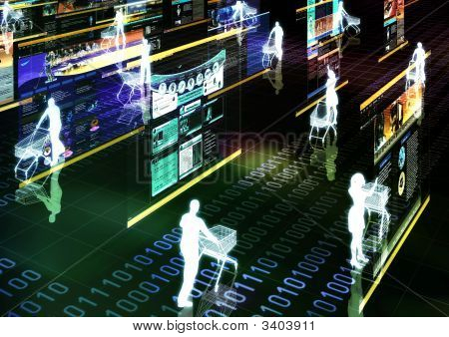
Summary and outlook

Slide 2
Agenda
Summary and outlook
  Summary
  Outlook
  References

Slide 3
Summary
Recommender systems have their roots in various research areas, such as
  information retrieval,
  information filtering, and
  text classification.
Recommender systems apply methods from different fields, such as
  machine learning,
  data mining, and
  knowledge-based systems.
Addressed main topics
  Basic recommendation algorithms
  Knowledge-based and hybrid approaches
  Evaluation of recommender systems and their business value
  Recent research topics

Slide 4
Outlook on the next-generation recommenders (1)
Improved collaborative filtering techniques
  Use more data sources such as tagging data, demographic information, and time data
  Combine different techniques (predictors)
  Automatic fine-tuning of parameters
More scalable and more accurate algorithms
  Netflix Prize competition (www.netflixprize.com) gave CF research an additional boost
Multicriteria recommender systems
  Exploiting multicriteria ratings containing contextual information as an additional source of knowledge for improving the accuracy
Context awareness
  Taking time aspects, geographical location and additional context aspects of the user into account
  Emotional context ("I fell in love with a boy. I want to watch a romantic movie.")
Group recommendations
  Accompanying persons? ("Recommendations for a couple or for friends?")

Slide 5
Outlook on the next-generation recommenders (2)
Better explanations that change the way the user interface works
More elaborate user interaction models
  Natural language processing techniques,
  dialog-based systems for interactive preference, and
  multimodal and multimedia-enhanced rich interfaces
  are important steps in the transition between classical recommender systems and virtual advisors.
Recommendation techniques will merge into other research fields
  User modeling
  Personalized reasoning
…
Next-generation recommenders might someday be able to simulate the behavior of an experienced salesperson instead of only filtering and ranking items from a given catalog.

Slide 6
Credits
Slide authors:
  Mouzhi Ge, TU Dortmund
  Fatih Gedikli, TU Dortmund
  Dietmar Jannach, TU Dortmund
  Zeynep Karakaya, TU Dortmund
  Markus Zanker, Alpen-Adria-Universitaet Klagenfurt

Slide 7
Thank you for your attention!
Questions?
Questions?
Questions?
ACM RecSys
Recommender Systems
http://recsys.acm.org
ACM SIGIR
Information Retrieval
http://www.sigir.org
ACM SIGKDD
Knowledge Discovery and Data Mining
www.sigkdd.org
IUI
Intelligent User Interfaces
http://iuiconf.org
http://www.recommenderbook.net
Recommender Systems –
An Introduction by
Dietmar Jannach, Markus Zanker,
Alexander Felfernig and Gerhard Friedrich
Cambridge University Press, 2011

