Slide 1
Attacks on collaborative recommender systems

Slide 2
Agenda
Introduction
Charactarization of Attacks
Attack models
Effectivness analysis
Countermeasures
Privacy aspects
Discussion

Slide 3
Introduction / Background
(Monetary) value of being in recommendation lists
  Individuals may be interested to push some items by manipulating the recommender system
  Individuals might be interested to decrease the rank of other items
  Some simply might may want to sabotage the system ..
Manipulation of the "Internet opinion"
  Malevolent users try to influence behavior of recommender systems
    System should include a certain item very often/seldom in its recommendation list
A simple strategy?
  (Automatically) create numerous fake accounts / profiles
  Issue high or low ratings to the "target item"
    Will not work for neighbor-based recommenders
    More elaborate attack models required
    Goal is to insert profiles that will appear in neighborhood of many

Slide 4
Example profile injection
Assume that a memory-based collaborative filtering is used with:
  Pearson correlation as similarity measure
  Neighborhood size of 1
    Only opinion of most similar user will be used to make prediction
 | Item1 | Item2 | Item3 | Item4 | … | Target | Pearson
Alice | 5 | 3 | 4 | 1 | … | ?
User1 | 3 | 1 | 2 | 5 | … | 5 | -0.54
User2 | 4 | 3 | 3 | 3 | … | 2 | 0.68
User3 | 3 | 3 | 1 | 5 | … | 4 | -0.72
User4 | 1 | 5 | 5 | 2 | … | 1 | -0.02

Slide 5
Example profile injection
Assume that a memory-based collaborative filtering is used with:
  Pearson correlation as similarity measure
  Neighborhood size of 1
    Only opinion of most similar user will be used to make prediction
 | Item1 | Item2 | Item3 | Item4 | … | Target | Pearson
Alice | 5 | 3 | 4 | 1 | … | ?
User1 | 3 | 1 | 2 | 5 | … | 5 | -0.54
User2 | 4 | 3 | 3 | 3 | … | 2 | 0.68
User3 | 3 | 3 | 1 | 5 | … | 4 | -0.72
User4 | 1 | 5 | 5 | 2 | … | 1 | -0.02
User2 most similar to Alice

Slide 6

Example profile injection
Assume that a memory-based collaborative filtering is used with:
  Pearson correlation as similarity measure
  Neighborhood size of 1
    Only opinion of most similar user will be used to make prediction
 | Item1 | Item2 | Item3 | Item4 | … | Target | Pearson
Alice | 5 | 3 | 4 | 1 | … | ?
User1 | 3 | 1 | 2 | 5 | … | 5 | -0.54
User2 | 4 | 3 | 3 | 3 | … | 2 | 0.68
User3 | 3 | 3 | 1 | 5 | … | 4 | -0.72
User4 | 1 | 5 | 5 | 2 | … | 1 | -0.02
Attack | 5 | 3 | 4 | 3 | … | 5 | 0.87
User2 most similar to Alice
Attack

Slide 7
Example profile injection
Assume that a memory-based collaborative filtering is used with:
  Pearson correlation as similarity measure
  Neighborhood size of 1
    Only opinion of most similar user will be used to make prediction
 | Item1 | Item2 | Item3 | Item4 | … | Target | Pearson
Alice | 5 | 3 | 4 | 1 | … | ?
User1 | 3 | 1 | 2 | 5 | … | 5 | -0.54
User2 | 4 | 3 | 3 | 3 | … | 2 | 0.68
User3 | 3 | 3 | 1 | 5 | … | 4 | -0.72
User4 | 1 | 5 | 5 | 2 | … | 1 | -0.02
Attack | 5 | 3 | 4 | 3 | … | 5 | 0.87
User2 most similar to Alice
Attack
Attack most similar to Alice

Slide 8
Characterization of profile insertion attacks
Attack dimensions
  Push attack:
    Increase the prediction value of a target item
  Nuke attack:
    Decrease the prediction value of a target item
  Make the recommender system unusable as a whole
No technical difference between push and nuke attacks
Nevertheless Push and Nuke attacks are not always equally effective
Another differentiation factor between attacks:
  Where is the focus of an attack? Only on particular users and items?
  Targeting a subset of items or users might be less suspicious
  More focused attacks may be more effective (attack profile more precisely defined)

Slide 9
Characterization of profile insertion attacks
Classification criteria for recommender system attacks include:
  Cost
    How costly is it to make an attack?
    How many profiles have to be inserted?
    Is knowledge about the ratings matrix required?
      usually it is not public, but estimates can be made
  Algorithm dependability
    Is the attack designed for a particular recommendation algorithm?
  Detectability
    How easy is it to detect the attack

Slide 10
The Random Attack
General scheme of an attack profile
  Attack models mainly differ in the way the profile sections are filled
Random attack model
  Take random values for filler items
    Typical distribution of ratings is known, e.g., for the movie domain
    (Average 3.6, standard deviation around 1.1)
  Idea:
    generate profiles with "typical" ratings so they are considered as neighbors to many other real profiles
  High/low ratings for target items
  Limited effect compared with more advanced models
Item1 | … | ItemK | … | ItemL | … | ItemN | Target
r_1 | … | r_k | … | r_l | … | r_n | X
selected items |  |  | filler items |  | unrated items

Slide 11
The Average Attack
use the individual item's rating average for the filler items
intuitively, there should be more neighbors
additional cost involved: find out the average rating of an item
more effective than Random Attack in user-based CF
  But additional knowledge is required
Quite easy to determine average rating values per item
  Values explicitly provided when item is displayed

Slide 12
Effectiveness
By the way: what does effective mean?
Possible metrics to measure the introduced bias
Robustness
  deviation in general accuracy of algorithm
Stability
  change in prediction for a target item (before/after attack)
In addition: rank metrics
  How often does an item appear in Top-N lists (before/after)

Slide 13
Bandwagon Attack
Exploits additional information about the community ratings
Simple idea:
  Add profiles that contain high ratings for "blockbusters" (in the selected items); use random values for the filler items
  Will intuitively lead to more neighbors because
    popular items will have many ratings and
    rating values are similar to many other user-profiles
Example: Injecting a profile with high rating values for the Harry Potter series
Low-cost attack
  Set of top-selling items/blockbusters can be easily determined
Does not require additional knowledge about mean item ratings

Slide 14
Segment Attack
Designing an attack that aims to push item A
Find items that are similar to target item,
  These items probably liked by the same group of people
  Identify subset of user community that is interested in items similar to A
Inject profiles that have
  high ratings for fantasy novels and
  random or low ratings for other genres
Thus, item will be pushed within the relevant community
For example: Push the new Harry Potter book
  Attacker will inject profile with positive ratings for other popular fantasy books
  Harry Potter book will be recommended to typical fantasy book reader
Additional knowledge (e.g. genre of a book) is required

Slide 15
Special nuke attacks
Love/hate attack
  Target item is given the minimum value
  Filler items are given the highest possible rating value
  Serious effect on system’s recommendations when goal is to nuke an item
  Other way around (push an item) it is not effective
Reverse bandwagon
  Associate target item with other items that are disliked by many people.
  Selected item set is filled with minimum ratings

Slide 16
Effectiveness analysis
Effect depends mainly on the attack size (number of fake profiles inserted)
User-based recommenders:
  Bandwagon / Average Attack:
    Bias shift of 1.5 points on a 5-point scale at 3% attack size
  Average Attack slightly better but requires more knowledge
  1.5 points shift is significant; 3% attack size means inserting e.g., 30,000 profiles into one-million rating database …
Item-based recommenders
  Far more stable; only 0.15 points prediction shift achieved
  Exception: Segment attack successful (was designed for item-based method)
  Hybrid recommenders and other model-based algorithms cannot be easily biased (with the described/known attack models)

Slide 17
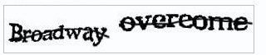
Countermeasures
Use model-based or hybrid algorithms
  More robust against profile injection attacks
  Accuracy comparable with accuracy of memory-based approaches
  Less vulnerable
Increase profile injection costs
  Captchas
  Low-cost manual insertion …

Slide 18
Countermeasures II
Use statistical attack detection methods
  detect groups of users who collaborate to push/nuke items
  monitor development of ratings for an item
    changes in average rating
    changes in rating entropy
    time-dependent metrics (bulk ratings)
  use machine-learning methods to discriminate real from fake profiles

Slide 19
Privacy aspects
Problem:
  Store and manage sensitive customer information
Detailed customer profiles are the basis for market intelligence
  Such as segmentation of consumers
Ensuring customer privacy
  important for success of a recommender system
  users refrain from using the application if privacy leaks get publicly known

Slide 20
Privacy aspects II
Main architectural assumption of CF-Recommender system is
  One central server holding the database and
  the plain (non-encrypted) ratings are stored in this database
Once an attacker achieved access to that system, all information can be directly used
Prevent such privacy breaches by
  Distributing the information or
  Avoiding the exchange, transfer or central storage of the raw user ratings.

Slide 21
Data perturbation
Main Idea: obfuscate ratings by applying random data perturbation
Server although does not know the exact values of the customer ratings
  Accurate recommendation can still be made because:
    The range of data is known
  Computation based on aggregation of obfuscated data sets
Tradeoff between degree of obfuscation an accuracy of recommendation
  The more "noise" in the data,
    the better users' privacy is preserved
    the harder the approximation of real data for the server

Slide 22
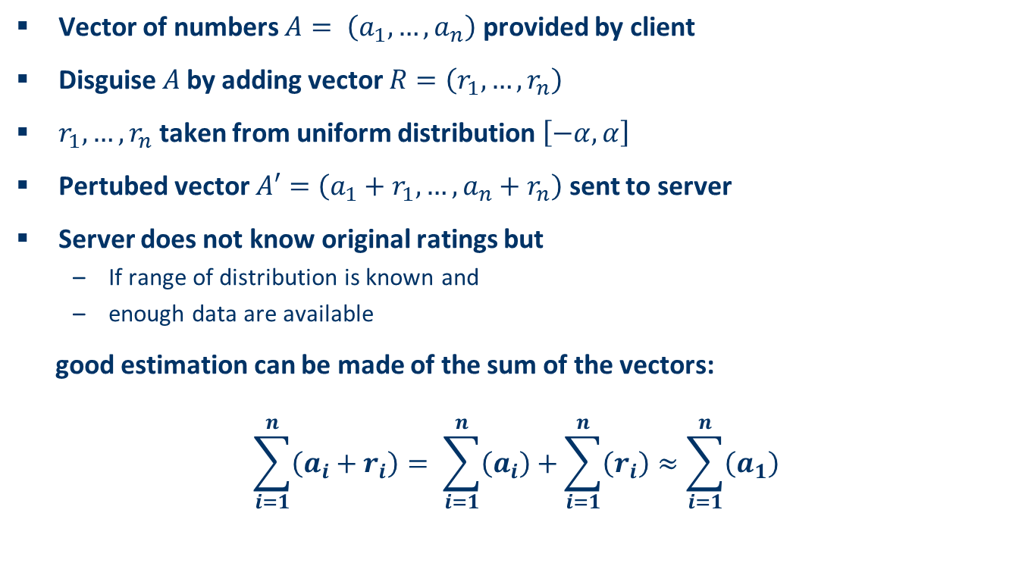
Data perturbation II
Vector of numbers $A= \left(a_{1},…,a_{n}\right)$ provided by client
Disguise $A$by adding vector $R=\left(r_{1},…,r_{n}\right)$
$r_{1},…,r_{n}$ taken from uniform distribution $\left[−α,α\right]$
Pertubed vector $A′=\left(a_{1}+r_{1},…,a_{n}+r_{n}\right)$ sent to server
Server does not know original ratings but
  If range of distribution is known and
  enough data are available
good estimation can be made of the sum of the vectors:
$$\sum_{i=1}^{n}{\left(a_{i}+r_{i}\right)}= \sum_{i=1}^{n}{\left(a_{i}\right)}+\sum_{i=1}^{n}{\left(r_{i}\right)}≈\sum_{i=1}^{n}{\left(a_{1}\right)}$$

Slide 23
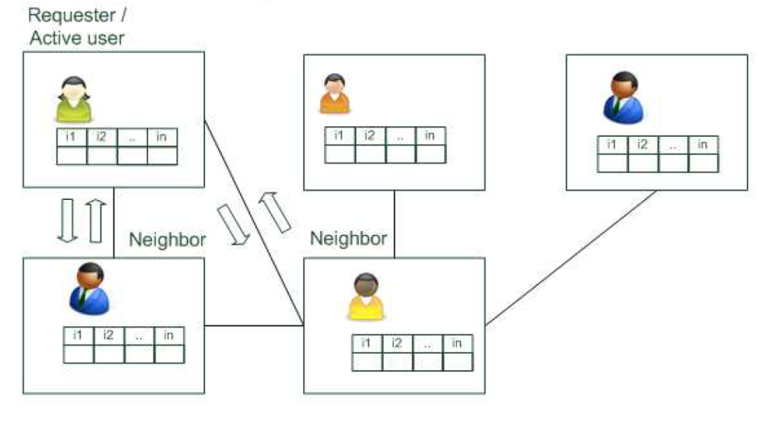
Distributed collaborative filtering
Distribute knowledge and avoid storing the information in one central place
Peer-to-peer (P2P) CF
  Exchange rating information in a scalable P2P network
  Active user broadcasts a query (vector of user´s item ratings)
  Peers calculate similarity between recieved and other known vectors
    If similarity > threshold, known ratings returned to requester
    If not, query forwarded to the neighboring peers
  Activ user calculates prediction
  with recieved ratings

Slide 24
Distributed collaborative filtering with obfuscation
Combines P2P data exchange and data obfuscation
Instead of broadcasting the "raw" profile only obfuscated version is published
Peers received this broadcast return a prediction for target item
Active user
  collects these answers and
  calculates a prediction using standard nearest-neighbor-method
Obfuscation will help to preserve privacy of participants
Advisable to perturb only profiles of respondent agents
Obfuscation of requester profile deteriorates recommendation accuracy

Slide 25
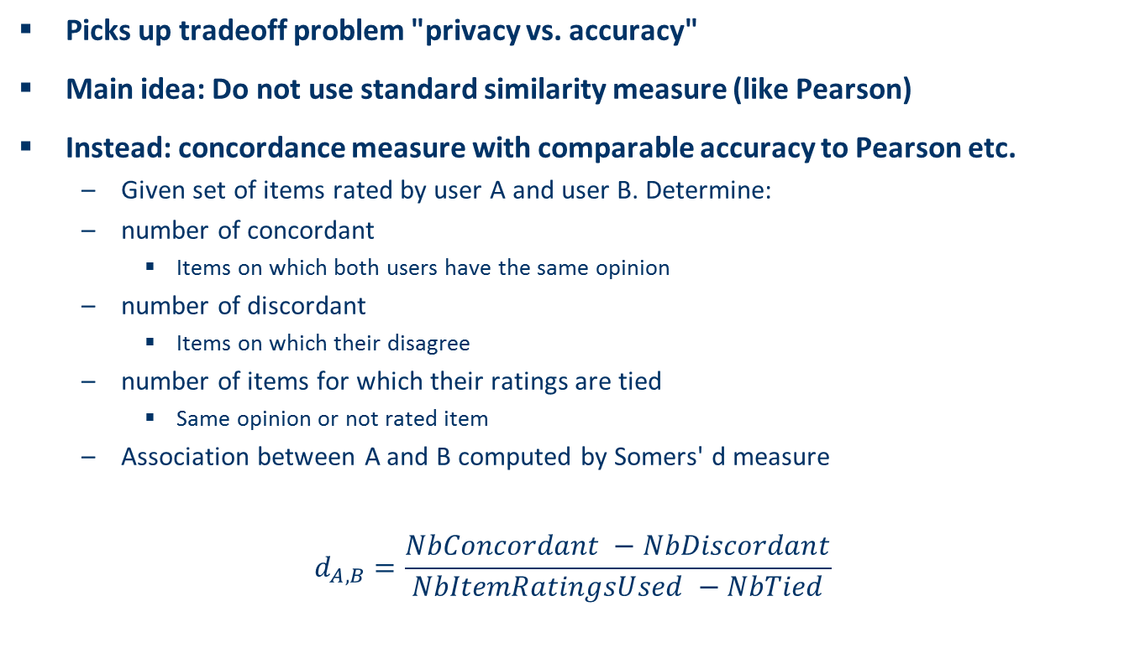
Distributed CF with estimated concordance measures
Picks up tradeoff problem "privacy vs. accuracy"
Main idea: Do not use standard similarity measure (like Pearson)
Instead: concordance measure with comparable accuracy to Pearson etc.
  Given set of items rated by user A and user B. Determine:
  number of concordant
    Items on which both users have the same opinion
  number of discordant
    Items on which their disagree
  number of items for which their ratings are tied
    Same opinion or not rated item
  Association between A and B computed by Somers' d measure
$$d_{A,B}=\frac{NbConcordant −NbDiscordant}{NbItemRatingsUsed −NbTied}$$

Slide 26
Community-building and aggregates
Participants of knowledge communities share information
  inside the community or
  with outsiders
Active user can derive predictions from shared information
Informations are aggregated based on e.g. SVD
Individual user ratings are not visible to users outside the community
Use of cryptographic schemes for secure communication between participants in the network

Slide 27
Discussion & summary
Research on attacks
  Vulnerability of some existing methods shown
  Specially-designed attack models may also exist for up-to-now rather stable methods
  Incorporation of more knowledge-sources /hybridization may help
Practical aspects
  No public information on large-scale real-world attack available
  Attack sizes are still relatively high
  More research and industry-collaboration required

